Slide 1
Food Business Boot Camp
Webinar series presented by Food Secure Canada
with support from the J.W. McConnell Family Foundation
Demystifying Food Safety
with Sylvia Caldwell, Food Technologist

Slide 2
Canadian Food Industry Regulation & Food Safety Requirements
Food Secure Canada Webinar
October 28, 2014

Slide 3
AGENDA
Canadian Food Law
Product Labelling
Premises Regulation & Food Safety
Federal Requirements
Provincial Requirements
Questions

Slide 4
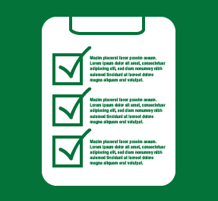
(1) CANADIAN FOOD LAW
Legislation - Written laws (often acts or statutes), enacted by Parliament.
Regulations – A form of law, defines the application and enforcement of legislation.
Guidelines – Departmental documents used to interpret legislation and/or regulation.
Notes:
CONSOLIDATED acts and regulations are those that are “official”, the term consolidated is used to describe an act or regulation that is current an incorporates all amendments or “amending” acts and regulations into the original text.

Slide 5
FEDERAL GOVERNMENT DEPARTMENTS
Health Canada – sets health and safety related requirements under the Food and Drug Act (FDA) and Safe Food for Canadians Act (SFCA).
Agriculture and Agri-Food Canada (AAFC) – responsible for policies governing agriculture production, farming income, research and development, inspection, and the regulation of animals and plants.
Canadian Food Inspection Agency (CFIA) – provides inspection services and regulatory oversight for food production, and plant and animal health products, and is responsible for the enforcement of the health and safety requirements in the Food and Drugs Act and Safe Food for Canadians Act.
Canadian Border Services Agency (CBSA) – ensures the security and safety of Canada by managing the access of people and goods to and from Canada, enforces many acts including Food and Drugs Act, Consumer Packaging and Labelling Act, Canada Agricultural Products Act, Meat Inspection Act, Fish Inspection Act.

Slide 6
CONSUMER PACKAGING AND LABELLING ACT & REGULATIONS
Applies to any prepackaged product sold in Canada.
Consumer Packaging and Labelling Act [CPLA] – An act respecting the packaging, labelling, sale, importation and advertising of prepackaged and certain other products.
Current to Sept. 29, 2014
Consumer Packaging and Labelling Regulations [CPLR]– sets forth mandatory label information such as bilingual labelling and the use of metric units of measurement. Both the FDR and CPLR contain provisions re. fraud and misrepresentation.
Current to Sept. 29, 2014
The CFIA enforces the CPLA by inspecting against the requirements in the CPLR.
[CPLA]: http://laws-lois.justice.gc.ca/eng/acts/c-38/
[CPLR]: http://www.laws.justice.gc.ca/eng/Regulations/C.R.C.,_c._417/index.html
Notes:
[CPLA] provides a uniform method of labelling and packaging consumer goods.

Slide 7
FOOD AND DRUG ACT & REGULATIONS
Applies to all food (and drugs) sold in Canada.
Food and Drugs Act [FDA]– An act respecting food, drugs, cosmetics and therapeutic devices.
Current to Sept. 29, 2014
Food and Drug Regulations [FDR] – regulations that prescribe the standards for labelling and composition of food and drugs.
Current to Sept. 29, 2014
The CFIA enforces the FDA by inspecting against the standards in the FDR.
[FDA]: http://laws-lois.justice.gc.ca/eng/acts/F-27/index.html
[FDR]: http://laws-lois.justice.gc.ca/eng/regulations/C.R.C.%2C%5Fc.%5F870/
Notes:
[FDR] prescribe the standards of composition, strength, potency, purity, quality or other property of the article of food or drug to which they refer.

Slide 8
SAFE FOOD FOR CANADIANS ACT
Establishes a framework for the safety of food commodities.
Safe Food for Canadians Act [SFCA] – An act respecting food commodities, including their inspection, their safety, their labelling and advertising, their import, export and interprovincial trade, the establishment of standards for them, the registration or licensing of persons who perform certain activities related to them, the establishment of standards governing establishments where those activities are performed and the registration of establishments where those activities are performed.
Current to Sept. 29, 2014
The supporting regulations that will bring into force the SFCA are in development. Initiatives under the SFCA include:
Labelling Modernization Initiative
Inspection Verification Teams
New Testing and Labelling Safeguards at Federal Meat Plants
?
[SFCA]: http://laws-lois.justice.gc.ca/eng/acts/S-1.1/index.html

Slide 9
SFCA – COMING INTO FORCE
(Previously proposed) | Currently “Registered” | FFV | Non-Registered
Licence | 2015 | 2015 | 2016
PCP | 2015 | 2016 | 2017
Draft regulations under the SFCA were released May 22, 2014 but only contains a subset of the proposed regulations and significant details were lacking.
Industry has (recently) proposed to the CFIA and Minister of Health that the coming into force of the new regulations be phased in over three years starting in January 2016.

Slide 10
(2) FOOD LABELLING
Purpose:
To enable consumers to make informed food choices based on information that is truthful and not misleading.
Provide basic product information.
Provide health, safety and nutrition information.
Acts as a vehicle for food marketing, promotion and advertising.
It is the responsibility of regulated parties to comply with the Food and Drugs Act [FDA] and the Consumer Packaging and Labelling Act [CPLA].
Food Labelling for Industry: http://www.inspection.gc.ca/food/labelling/food-labelling-for-industry/eng/1383607266489/1383607344939
Labelling Requirements Checklist:
http://www.inspection.gc.ca/food/labelling/food-labelling-for-industry/labelling-requirements-checklist/eng/1393275252175/1393275314581

Slide 11
FOOD PRODUCTS THAT REQUIRE A LABEL
[FDR B.01.003] The following foods shall carry a label when offered for sale:
All prepackaged products other than:
Prepackaged confections, commonly known as one-bite confections, that are sold individually [B.01.003(1)(a)(i), FDR; 4(3,) CPLR];
Prepackaged products consisting of fresh fruits or fresh vegetables that are packaged in a wrapper less than ½ inch in width, including products packaged in a clear, colourless transparent wrapper (e.g. shrink wrap) on individual units of fresh produce with no graphic information other than a price sticker, bar codes, number codes, environmental statements and product treatment symbols [B.01.003(1)(a)(ii), FDR; 4(4), CPLR];
Raspberries or strawberries packaged in the field in containers 1.14 L or less [4(5), CPLR];
Soft drink containers that are re-used by a dealer, permanently labelled with any information required, and manufactured prior to March 1, 1975 [4(2), CPLR].

Slide 12
FOOD PRODUCTS THAT REQUIRE A LABEL
(b) Meat and meat by-products that are barbecued, roasted or broiled on the retail premises [B.01.003(1)(b), FDR];
(c) Poultry, poultry meat or poultry meat by-products that are barbecued, roasted or broiled on the retail premises [B.01.003(1)(c), FDR];
(d) Horse-meat or horse-meat by-product [B.01.003(1)(d), FDR];
(e) Any substance or mixture of substances for use as a food additive or food additive preparation [B.01.003(1)(e), FDR], and;
(f) Flour and whole wheat flour that has been treated with gamma radiation from Cobalt 60 Source [B.01.003(1)(f), FDR].
Notes:
Temperature should be less than 4C or greater than 60C.

Slide 13
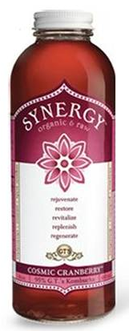
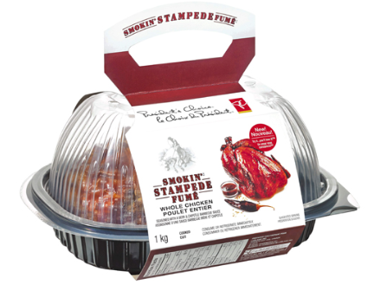
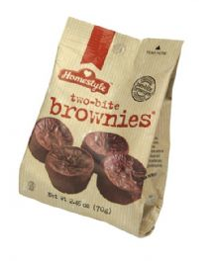
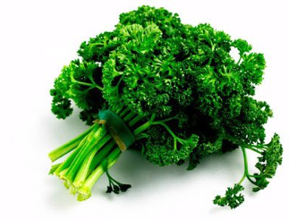
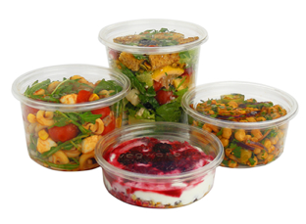
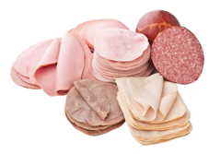
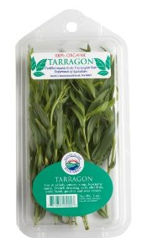
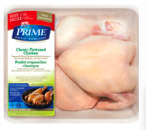
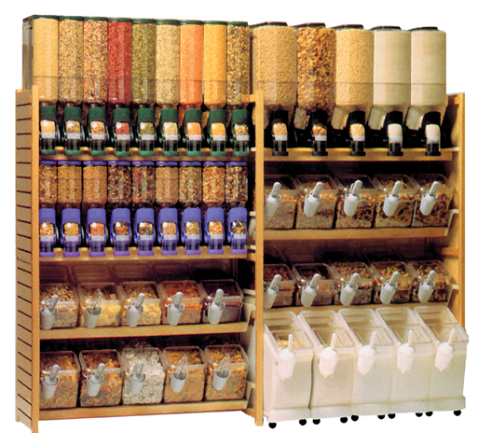
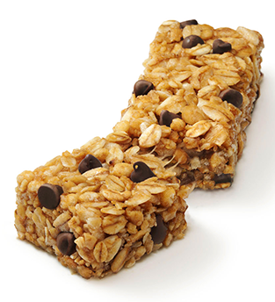
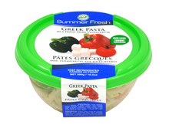
Food Labelling Examples
Foods that do not require a label:
Foods that require a label:

Slide 14
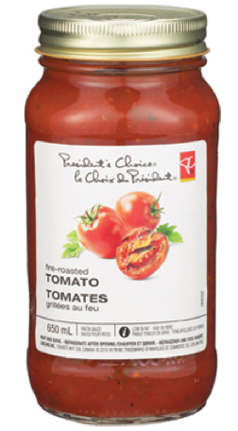
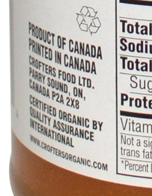
MANDATORY LABEL REQUIREMENTS
1. Product Identity Declaration on Principal Display Panel
English and French*
Min type height of 1.6 mm (1/16 inch), based on lowercase “o”
3. Dealer Name and Place of Business anywhere on the outside surface except the bottom.
English or French
Specific requirements for imported goods, bulk imports (repackaged), and Country of Origin (for specific goods)
2. Net Quantity Declaration on Principal Display Panel
English and French*
Metric units
-in volume, when liquid, a gas, or is viscous
-in weight, when the product is solid
-by numerical count, when sold in individual units
-by specific trade practice (length)
-specific requirements for units (symbols, spacing, choice of units, precision and rounding)
Type height based on Principal Display Surface
Notes:
Note that the Province of Quebec has additional requirements concerning the use of French language on all products within its jurisdiction.
An example of Country of Origin requirement for bulk imports is importation of dried spices, wholly produced outside of Canada, repackaged (other than by a retailer), it must be labelled with “Imported by dealer name and place of business”

Slide 15
DATE MARKINGS
Prepackaged products with a durable life of less than 90 days and packaged at a location other than the retail premises must be marked with a durable life date (also known as a best before date), and storage instructions (if they differ from normal room temperature).
Storage instructions are mandatory for products that require storage conditions that differ from normal room temperature.
Prepackaged products with durable life of 90 days or less that are packaged on the retail premises must be marked with the packaging date, and the durable life is required to be on the label or poster next to the food.

Slide 16
FOOD-SPECIFIC REQUIREMENTS
There are requirements specific to the type of product, such as grades, standards and compositional requirements.
Alcohol
Dairy
Eggs – Shelled
Fish and Seafood
Fresh Fruit and Vegetables
Honey
Maple
Processed Products
Shipping Containers
Chocolate and Cocoa
Eggs – Processed
Fats and Oils
Foods for Special Dietary
Grain and Bakery
Infant and Junior Food
Meat and Poultry
Salt
Water
http://www.inspection.gc.ca/food/labelling/food-labelling-for-industry/eng/1383607266489/1383607344939
Notes:
Use the labelling tool for industry to navigate these requirements.

Slide 17
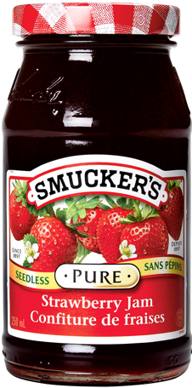
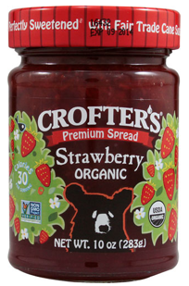
What’s in a Name?
Common Name | Strawberry Jam | Premium Spread (Strawberry)
Standardized Container Size | Yes | N/A
Registration Number | Required, if applicable
Compositional Requirements / Standards of Identity: | Not less than 45% of the named fruit; 66% water soluble solids; May contain added pectin, antifoaming agent, preservative; May not contain apple or rhubarb; fruit pulp preserved in sulphur dioxide. | No
Compositional requirements, grading and standards of identity must be met, even if you are only selling your product locally.
Notes:
*Not required but recommended for food safety
Note that if this product were to be called Strawberry Jam with pectin, different compositional standards would apply, for example, it may contain food colour and not less than 27% of the named fruit. % soluble solids is the same.
Use the checklist!

Slide 18
NUTRITION LABELLING
Legislated Information:
Ingredient List (and allergens)
Nutrition Facts Table
Optional nutrition claims (not covered in this webinar)
Nutrition Labelling for Industry: http://www.inspection.gc.ca/food/labelling/food-labelling-for-industry/nutrition-labelling/eng/1386881685057/1386881685870

Slide 19
LIST OF INGREDIENTS
Ingredients and components are required to be declared on all prepackaged foods.
Exemptions from Ingredient Listing:
Prepackaged packed from bulk at retail (except mixed nuts and meat products containing phosphate salts and/or water).
Prepackaged individual portions of food served with meals or snacks by restaurants, airlines, etc.
Prepackaged individual servings of food prepared by commissaries and sold in mobile canteens or vending machines.
Prepackaged meat/poultry meat products and by-products that have been barbecued, roasted or broiled on the retail premises.
Bourbon whiskey and standardized alcoholic beverages.
Standardized vinegars.

Slide 20
LIST OF INGREDIENTS
Order of ingredients is listed in descending order of their proportion by weight of a prepackaged product [B.01.008(3), FDR].
The following can be listed at the end of the ingredients list in any order [B.01.008(4), FDR]:
Spices, seasonings, herbs (except salt);
Natural and artificial flavours;
Flavour enhancers;
Food additives, except ingredients of food additive preparations or mixtures of substances for use as a food additive;
Vitamins and their salts or derivatives of vitamins;
Mineral nutrients and their salts.

Slide 21
LIST OF INGREDIENTS
Ingredients that do not have to be declared:
Wax coating compounds
Sausage casings
Hydrogen
Components (ingredients of ingredients):
Declared by their common name in descending order or proportion [B.01.008(5), FDR]; or,
In descending order of proportion by weight in the finished food as if they were ingredients [B.01.008(5)(b), FDR].
Ingredients of the third generation and so on are not generally required to be included in the ingredients list (note exception applies for allergenic ingredients of any generation – they must still be declared.
See Ingredients Exempt from Component Declaration [B.01.009(1), FDR].

Slide 22
ALLERGEN DECLARATION
Undeclared allergens are the #1 cause of food recalls in Canada.
CFIA Top 10 List:
Eggs
Milk
Mustard (and canola meal)
Peanuts
Seafood (fish, crustaceans, shellfish)
Sesame
Soy
Sulphites
Tree Nuts
Wheat (Triticum spp.)

Slide 23
FOOD ALLERGENS, GLUTEN AND ADDED SULPHITES DECLARATION
Food allergens and gluten must be declared in one of two ways:
Declared on the list of ingredients (example 1).
In a “contains” statement (example 2).
Example 1:
Ingredients: Flour (wheat), liquid albumen (egg), vegetable oil, sugar, flavour.
Example 2:
Ingredients: Chick peas, lemon juice, tahini, garlic. Contains sesame.
SULPHITE DECLARATION:
Required to be declared when added directly as an ingredient or component of an ingredient that is not exempt from component declaration.
If added sulphites are present in a prepackaged product in the 1st generation (ingredient) or 2nd generation (component) and not exempt from declaration, they must be declared in the list of ingredients regardless of their quantity.
Notes:
Use appropriate (prescribed) source names for the allergen or gluten.

Slide 24
ALLERGEN DECLARATION
Exemptions from Allergen Declaration:
Products exempt from bearing a List of Ingredients are also exempt from allergen declaration unless a list of ingredients is voluntarily shown on the product’s label. This includes Standardized Beer, Ale, Stout, Porter, and Malt Liquor.
Distilled vinegars and standardized alcohols are required to declare allergens regardless of the fact that they are exempt from bearing a list of ingredients.
Products exempt from bearing a label are also exempt from allergen declaration unless a label with a list of ingredients is voluntarily applied to the product.

Slide 25
NUTRITION FACTS TABLE (NFT)
Exempt from requiring NFT:
Fresh fruits and vegetables or combination of, without any added ingredients or coated with paraffin wax or petrolatum.
Raw single ingredient meat/poultry meat, meat/poultry meat by-product, marine or freshwater animal product.
Milk/goat’s milk, partly skimmed milk/goat’s milk, skim milk/goat’s milk, (naming the flavour) milk/goat’s milk products above, cream that are sold in a refillable glass container.
Foods containing very few nutrients such as coffee, tea, herbs and spices (usually exempt).
Alcoholic beverages with alcohol content >0.5%.
One-bite confections sold individually.
Foods prepared or processed at the store (bakery items, salads, etc) including a pre-mix.
Prepackaged individual portions solely intended to be served by a restaurant or other enterprise with meals and snacks.
Food sold at temporary markets by the individual who prepared and processed the product (does not apply to enterprises).
An individual serving that is sold for immediate consumption and has not been subjected to a process to extend its durable life, including special packaging.
Products sold where it is packaged, if the product is labelled by means of a sticker and has ADS of less than 200 cm².
Notes:
Loss of exemption: (a) vitamin/mineral nutrient is added, (b) ground meat/poultry meat products/by-products with a health or function claim, name, trade-mark, statement, logo, symbol, or seal of approval, use of the terms “nutrition facts”, “valeur nutritive” or “valeurs nutritives”, use of nutrient content claims.

Slide 26
FOODS PROHIBITED FROM DISPLAYING A NFT
[B.01.401(4) and B.01.401(5), FDR]:
Formulated liquid diets;
Infant formula;
Foods containing infant formula;
Meal replacements;
Nutritional supplements (that meet the requirements of B.24.201, FDR);
Food represented for use in very low energy diets.

Slide 27
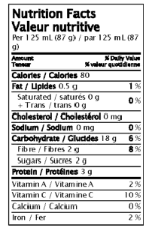
NUTRITION LABELLING
Nutrition Fact Table Core Requirements:
1. Serving Size
Reference Amounts
7. Amount of Cholesterol (mg)
8. Amount of Sodium
(mg, %DV)
2. Energy value
(Calories/Total Calories/Calories, Total
9. Amount of Carbohydrate
(mg, %DV)
3. Amount of Fat
(g, %DV)
10. Amount of Fibre (mg, %DV)
11. Amount of Sugars (g)
4. Saturated fatty acids (SFA) (g)
5. Trans fatty acids (TFA) (g)
6. The sum of SFA + TFA
(%DV)
12. Amount of Protein (g)
13. Amount of Vitamin A, Vitamin C, Calcium, Iron (%DV)
%DV = % Daily Value

Slide 28
NFT HOW-TO
Develop accurate nutrient values (direct method: product sampling + lab analysis, or indirect method: calculated from ingredient specific information or derivation from non-specific product information).
Measure the available display surface (ADS) of your package.
Choose a Nutrition Facts Table Format Family.
Choose the Appropriate Nutrition Facts Table using Decision Trees.
Guide to Developing Accurate Nutrient Values: http://www.hc-sc.gc.ca/fn-an/alt_formats/hpfb-dgpsa/pdf/label-etiquet/guide-nutri_val_tc-tm-eng.pdf

Slide 29
OPTIONAL CLAIMS & STATEMENTS
“Claim” – any representation which states, suggests or implies that a food has particular characteristics relating to its origin, nutritional properties, nature, production, processing, composition or any other quality [Codex Alimentarius, 2009].
Types of Claims:
Advertising
Composition and Quality
Method of Production
Organic
Nutrient Content
Allergens and Gluten
Health Claims
Pictures, Vignettes, Logos and Trade-marks
Origin

Slide 30
ORGANIC CLAIMS
Imported or inter-provincially traded agricultural products making an organic claim must be certified under the Canada Organic Regime [COR].
Certification is performed by CFIA-accredited certification bodies [Part 2, Organic Products Regulations (OPR)], operators must develop an organic production system based on these Canadian Organic Standards:
CAN/CGSB 32.310 Organic Agriculture: General Principles and Management Standards
CAN/CGSB 32.311 Organic Agriculture: Permitted Substances List
Not Permitted:
“100% Organic” or “100% Organic (Product Name)”
“Certified Organic”
“Made with Organic Ingredients”
Notes:
This includes products that:
are labelled as “organic”;
bear the Canada organic logo; and,
declare “contains x% organic ingredients”.

Slide 31
ORGANIC CLAIMS
Organic Content 95% - 100%
Permitted claims: “organic”, “organically grown”, “organically raised”, “organically produced”, “contains x% organic ingredients”
Multi-Ingredient Products with Organic Content 70-95%
Permitted claims: “contains x% organic ingredients”;
The words “organic ingredients” must be of the same type size and prominence as the preceding numbers, signs or symbols that indicate the applicable percentage [24(2), OPR];
Organic ingredients must be identified in the list of ingredients [25(b), OPR]; and,
Label of organic product subject to the OPR must bear the name of the certification body that has certified the product as organic [25(a), OPR].
Multi-Ingredient Products containing less than 70% Organic Content
Organic ingredients may be identified on the list of ingredients as organic; and,
Use of logo or claims is not permitted.

Slide 32
BILINGUAL LABELLING
Bilingual Requirement
Mandatory label information must be shown in both official languages.
The following can be shown in one official language:
Identity & principal place of business of person/organization responsible for the prepackaged product [B.01.012(9), FDR; 6(2), CPLR].
Common name of certain alcoholic beverages, if they appear on the principal display panel exactly as shown [B.01.012(10), FDR].
Exemptions:
Shipping containers
Specialty foods
Local foods
Test market foods

Slide 33
(3) PREMISES REGULATION & FOOD SAFETY
Are you provincially or federally regulated?
Where are you selling your product(s)?
Within your province or across provincial borders within 50 km of the originating province/territory
Inter-provincially
Export outside of Canada
Provincially regulated
Federally regulated

Slide 34
FEDERAL PREMISES REQUIREMENTS
The CFIA’s Food Safety Enhancement Program sets forth specific food safety requirements for food processing facilities.
Enabling Act | Supporting Regulation | Permissions | Period | Inspection & Enforcement
Safe Food for Canadians Act | Expected to be released in 2015 | Licences issued by the Canadian Food Inspection Agency (conditions) | 2 yrs | CFIA Inspectors ensure compliance to the Safe Food for Canadians Act and supporting regulations.
Conditions of Licensing:
Develop, implement and maintain a written preventative control plan (PCP) to meet food safety & other regulatory requirements;
Complete licensing application;
Pay the licence fee.
Proposed Exemptions:
Alcoholic beverages
Food additives
Micro businesses <$30K

Slide 35
FEDERAL FOOD SAFETY REQUIREMENTS
Preventative Control Plan (PCP): A systems-based approach that focuses on prevention as a way to achieve regulatory compliance.
A PCP suitable to the operations must be developed, documented, implemented, and maintained, as a condition of licence.
Licence holders and other regulated parties must:
monitor and control their operations
correct any deviations that occur
maintain ongoing compliance
PCPs must be made available to the CFIA upon request.
Allows operators to choose from different food safety benchmarks or private certification schemes, such as GFSI. The benchmark used by the CFIA in the Food Safety Enhancement Program is HACCP.
Notes:
Operators who choose GFSI as their benchmark are usually meeting customer requirements, GFSI is “Global Food Safety Initiative”

Slide 36
HACCP & PREREQUISITE PROGRAMS
Prerequisite Program (PRP) defines the basic conditions and activities that are necessary to maintain a hygienic environment through the food chain suitable for the production, handling, and provision of safe end products and safe food for human consumption.
Elements of a PRP:
Premises
Transportation, Purchasing, Receiving, Shipping & Storage
Equipment
Personnel
Sanitation & Pest Control
Recall
Operational Prerequisite Programs
The proposed PCP elements are similar to a PRP program, except that the PCP must apply critical limits to address specific hazards and address regulatory requirements such as labelling and composition .
Notes:
The PREREQUISITE PROGRAMS TO HACCP are seven programs that will address 90-95% of the hazards in an establishment. HACCP plans are built upon the prerequisite programs, and address hazards specific to the product/process.

Slide 37
PROVINCIAL/TERRITORIAL REGULATIONS
PROVINCE | Enabling Act | Supporting Regulation | Permissions | Period | Inspection & Enforcement
Alberta | Alberta Public Health Act | Alberta Food Regulation | Permit issued by Alberta Health Services | 1 yr | Public Health Inspectors ensure compliance to the Alberta Public Health Act and Food Regulation. Prescribed inspection schedule.
British Columbia | BC Public Health Act | Food Premises Regulation of BC | Food Premises Operating Permit issued by the Regional Health Authority | 1 yr | Public Health Inspectors ensure compliance to the BC Public Health Act and the Food Premises Regulation of BC
Manitoba | Manitoba Public Health Act | Food and Food Handling Establishments Regulation | Food Premises Health Permit issued by Manitoba Health | 1 yr | Public Health Inspectors ensure compliance to the Manitoba Public Health Act and Food and Food Handling Establishments Regulation.
Ontario | Health Protection and Promotion Act | Food Premises Regulation [O. Reg. 562] Food Safety Protocol Ontario Public Health Standards | Current inventory or inventories of all food premises is maintained within the health unit of each municipality’s public health unit. | N/A | Public Health Officers inspect food premises
Notes:
NOTE: Slaughter/Meat/Meat products are not covered in this summery. Meat is either federally or provincially licensed, and subject to food safety requirements specific to the activity. For example, a slaughterhouse in BC would not obtain a Food Premises Operating Permit, but a license to operate a salughterhouse in whichever class that applies. There is one exception, and in the Quebec Regulations respecting food, it is interpreted that permits are essentially only required by meat and dairy operators.

Slide 38
PROVINCIAL/TERRITORIAL REGULATIONS
PROVINCE | Enabling Act | Supporting Regulation | Permissions | Period | Inspection & Enforcement
Saskatchewan | Public Health Act | Food Safety Regulation | Licences issued by the local health authority (13 regions). | 2 yrs | Regional Health Inspectors ensure compliance to the Public Health Act and Food Safety Regulation.
Quebec | Food Products Act | Regulation Respecting Food | Required of: Meat (slaughter, processing) Dairy (plant, transport, dairy product substitute processing) Permits issued for specific activities, such as canned goods: canned meat or seafood. | 1 yr | City of Montreal Food Inspection Program. All other locations: Minstère de l’Agriculture, des Pêcheries et de l’Alimentation du Québec’s Food Inspection Program
New Brunswick | Public Health Act | Food Premises Regulation | Food premises licence issued by the New Brunswick Health Protection Branch (Department of Health). | 1 yr | Regional Public Health Inspectors ensure compliance to the Public Health Act and the Food Premises Regulation. See Regional Health Protection Branch Offices.
Nova Scotia | Public Health Act | Food Safety Regulations | Food handling permit issued by Nova Scotia Department of Agriculture – Food Protection and Enforcement Section | 1 yr | The Food Safety Section of of the NSDA inspects food operations and ensure compliance to the Public Health Act and Food Safety Regulations.
Notes:
Similar to the federal system, PEI’s provincial food safety regulations are also reported to be updated/upgraded.

Slide 39
PROVINCIAL/TERRITORIAL REGULATIONS
PROVINCE | Enabling Act | Supporting Regulation | Permissions | Period | Inspection & Enforcement
Newfoundland & Labrador | Food and Drug Act | Food Premises Regulation | Licences issued by the Government Service Centre, Department of Government Services & Lands (Department of Health and Community Services) | Does not expire | Newfoundland & Labrador Public Health Division inspects food premises.
Prince Edward Island | Public Health Act | Food Premises Regulations | Food Safety Program operated by the Chief Public Health Office, Department of Health and Wellness | 1 yr | Provincial Health and Wellness inspectors enforce health regulations.
Yukon | Public Health & Safety Act | Not found | Permits issued by Yukon Health and Social Services |  | Health Inspectors (Yukon Health & Social Services), see Food Premises Inspection Model
Northwest Territories | Public Health Act | Food Establishment Safety Regulations | Food establishment permits are required. | 1 yr | Inspections carried out by the Department of Health and Social Services – Environmental Health Division
Nunavut | Public Health Act | Not found but noted in PHA that the Commissioner may make regulations re. food premises and inspection

Slide 40
PROVINCIAL/TERRITORIAL FOOD SAFETY REQUIREMENTS
Province | Premises | Transportation, Purchasing, Shipping, Receiving & Storage | Equipment | Sanitation & Pest Control | Recall Program | Personnel | Food Safety Certification/Training | Allergen Control | CCPs
Alberta | R | R | R | R,D |  | R | R
British Columbia | R | R | R | R |  | R | R |  | R,D
Manitoba | R | R |  | R |  | R | Winnipeg by-law requires training
Ontario | R | R | R |  |  |  | Region-specific
Quebec | R | R | R | R |  | R | R
New Brunswick | R | R | R | R | R | R | R
Nova Scotia | R | R | R |  | Complaint system | R | R |  | QAP to address hazards
Notes:
Alberta notes:
-Documented pest control required.
-Separation of chemicals.
-Building/modification of facility, plans must be approved.
BC notes:
-FPR also covers restaurants/foodservice.
-Premises to which the FPR does not apply – food banks, and those governed by the Milk Industry Act, Fish Inspection Act, Meat Inspection Regulation.
-Training requirement is Foodsafe/equivalent.
Manitoba notes:
-Requirements are not highly detailed.
Ontario notes:
Quebec notes:
Permits are only required for meat and dairy (and dairy substitiute) facilities, and restaurants (agri-tourism) but provisions in the food products act apply to all food premises.
Training requirement: food handlers, 6 hours (GMP, hygiene, types of hazards, sanitation procedures) certificate, food est. manager 12 hours, includes hazard analysis
Suplier records required (lot information
NFLD & Labrador –nhave standards for certain products (micro standards)

Slide 41
PROVINCIAL/TERRITORIAL FOOD SAFETY REQUIREMENTS
Province | Premises | Transportation, Purchasing, Shipping, Receiving & Storage (and handling) | Equipment | Sanitation & Pest Control | Recall Program | Personnel | Food Safety Certification/Training | Allergen Control | CCPs
Newfoundland & Labrador | R | R | R | R |  | R
Prince Edward Island | R | R | R | R |  | R
Saskatchewan | R | R | R | R | R,D | R | R
Yukon | R | R | R | R |  | R
Northwest Territories | R | R |  | R |  | R | R
Nunavut
Notes:
Nunavut – no specific requirements found

Slide 42
BEYOND THE REQUIREMENTS - BUILDING YOUR FOOD SAFETY PLAN
What are your reasons for building a food safety plan?
What are your specific requirements? Are there benchmarks you need to/want to meet such as HACCP or GFSI?
What are the food safety gaps specific to your business/operations? What do you need to do to close the gaps?
How do you prioritize items in your work plan?
Notes:
-provincial regs don’t usually come with guidance documents
-provicinial requirements don’t necssarily address high priority risks for a facility.
IYFF example: allergen control, pathogen control – not required by provincial regs but important to the facility.
-federal food safety requirements are being enhanced/standardized to keep pace with the world – will we see stricter requirements in future? PEI already modernizing (reported in 2014). What’s next?

Slide 43
FOOD SAFETY PLANS – NEED HELP?
PROVINCE | PROGRAM (Growing Forward 2)
Alberta | Food Safety Systems – Processor Traceability Technology Adoption
British Columbia | Post-Farm Food Safety Program Traceability Adoption Program
Manitoba | Growing Assurance – Food Safety Processing and Distribution
Ontario | Assurance Systems (Food safety, traceability, animal welfare)
New Brunswick | N/A
Quebec | Salubrité, biosécurité, traçabilité et santé et bien-être des animaux (Safety, Health, Biosecurity, Traceability and Animal Welfare)
Nova Scotia | N/A
Saskatchewan | On-Farm Food Safety Implementation Program, Food Safety Systems (Value-Added Business Development)
Newfoundland & Labrador | Food Safety, Biosecurity and Traceability Initiative
Prince Edward Island | Assurance Systems Program (On-Farm and Post-Farm Assurance Systems)
Nunavut | N/A
Northwest Territories | Food Safety Program
Yukon | Food Safety, Food Safety Beneficial Management Practices
Notes:
Note: no current programs indicated by “N/A”,

Slide 44
QUESTIONS?

