Slide 1
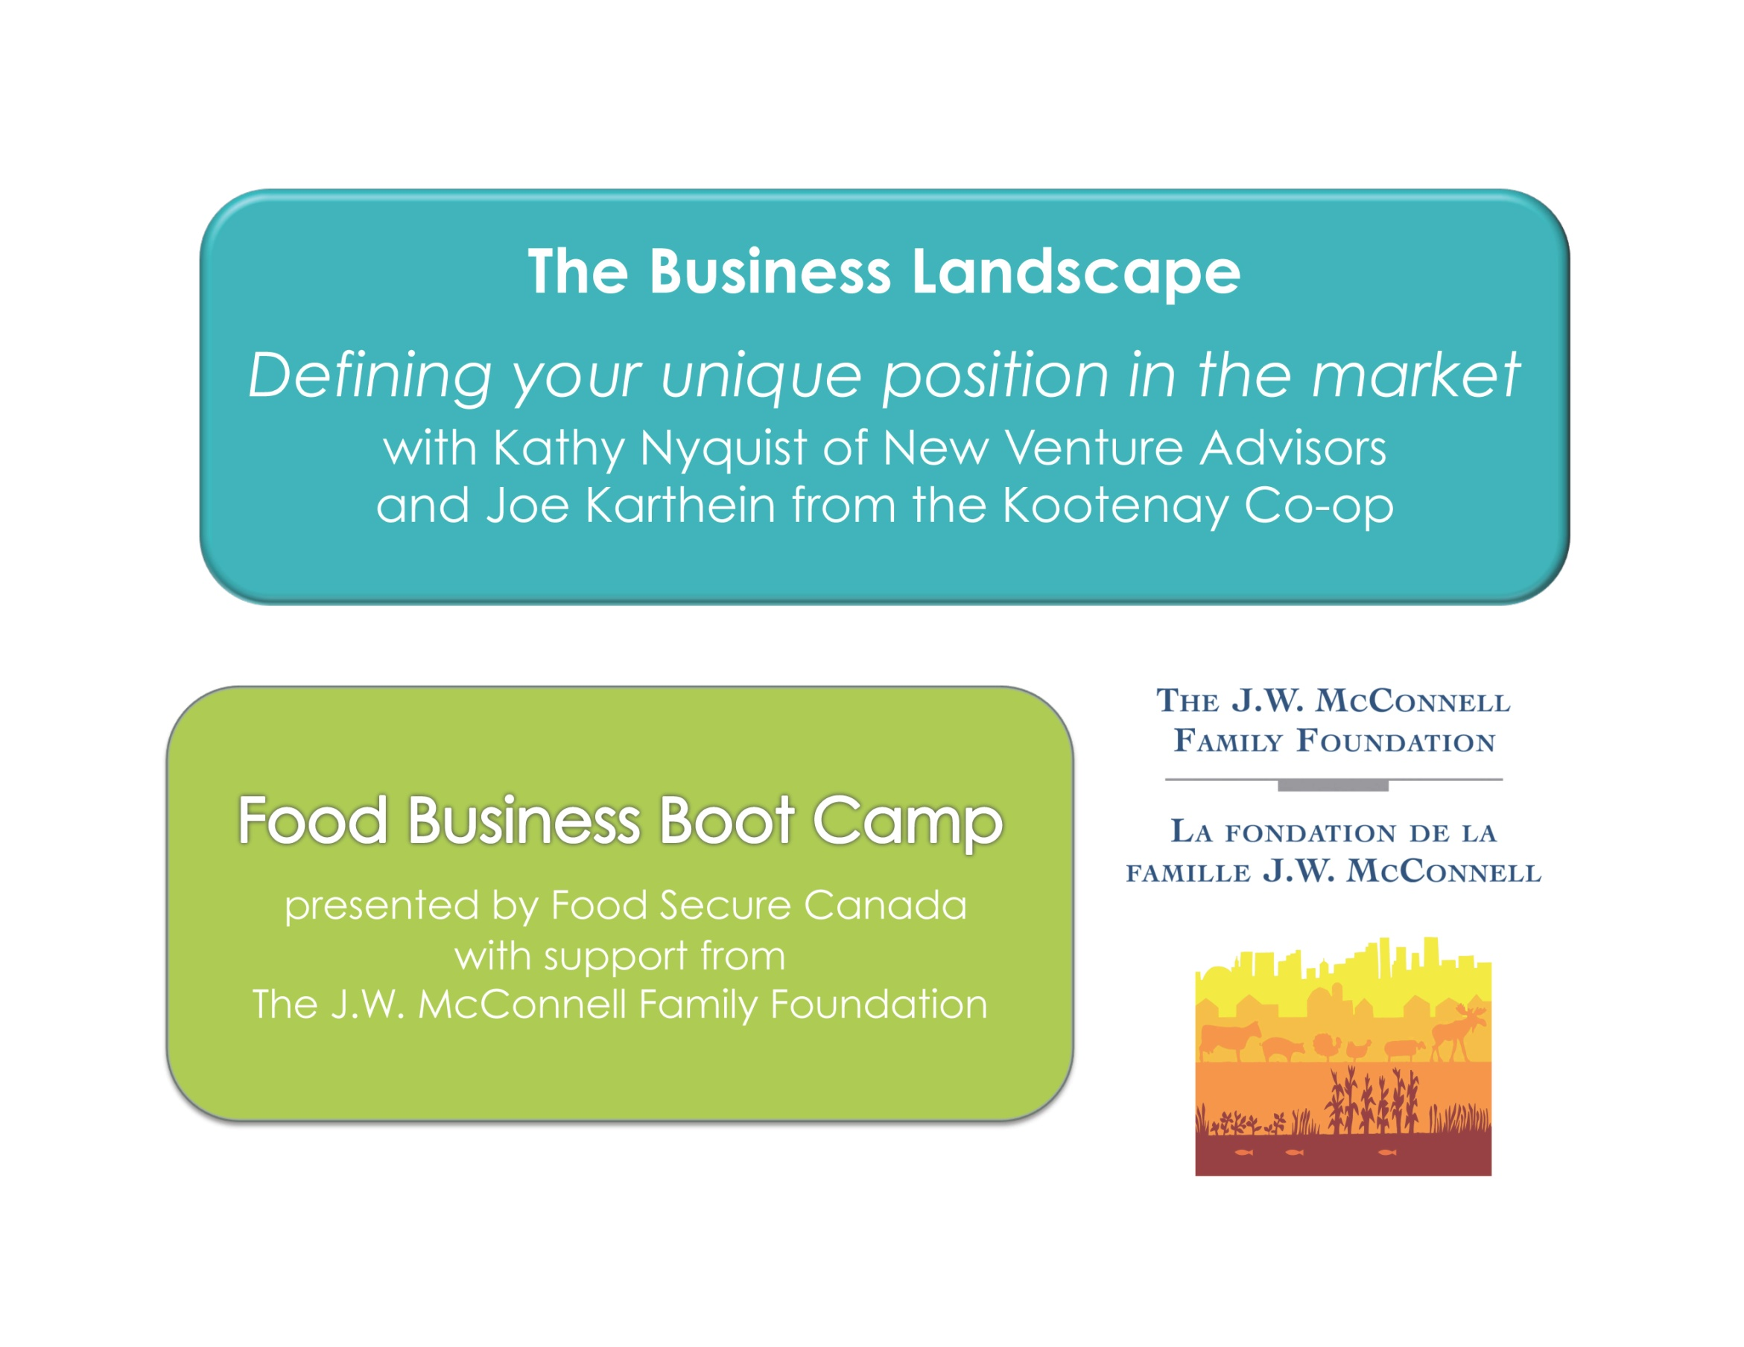

Slide 2

The Business Landscape
Session One
October 9, 2013
Kathy Nyquist
Principal, New Venture Advisors LLC
Chicago, IL (773) 245-3570 newventureadvisors.net

Slide 3

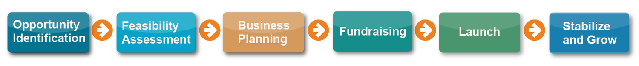
1
Opportunity Identification
Environmental Assessment

Slide 4
2
Feasibility Assessment
Shape Concept
Test Viability
Environmental Assessment

Slide 5
3
Business Planning
Strategic Plans
Pro Forma
Environmental Assessment
Shape Concept
Test Viability

Slide 6
4
Fundraising
Financing Plan
Investor Pitch
Environmental Assessment
Shape Concept
Test Viability
Strategic Plans
Pro Forma

Slide 7
5
Launch
Phased Development
Lean Startup
Environmental Assessment
Shape Concept
Test Viability
Strategic Plans
Pro Forma
Financing Plan
Investor Pitch

Slide 8
6
Stabilize and Grow
Finance, Marketing, Operations
Growth Strategy
Environmental Assessment
Shape Concept
Test Viability
Strategic Plans
Pro Forma
Financing Plan
Investor Pitch
Phased
Development
Lean Startup

Slide 9
Background
  1=strongly disagree 4=strongly agree
  Survey questions informing this Section
Able to clearly state our mission to attract investors and clients | 2.9
Know our solution is the right one and how it is differentiated | 3.3
Have a strong business model | 2.6
Have a clear understanding of and plan for our business offerings | 3.0
Able to define our market, its potential size, future customers | 2.9
Undertaken a thorough industry / sector analysis | 2.5
Understand our competition | 2.8
Understand our competitive advantages and disadvantages | 2.9

Slide 10
Objective
To clearly define your unique position in the market
    For listeners in assessment mode you will design a better business
    For listeners in operations mode you will strengthen your understanding of the market in which you compete
    and how to communicate with customers

Slide 11
Agenda
  Webinar 1 will help you:
  Webinar 2 will help you:
Define who you are
mission, business model, value proposition
Define the customer
segmentation, target market selection
Define the industry and market
size, structure, trends
Understand the field
competitive landscape
Know why you will win
differentiation, barriers
Develop your brand
brand foundations

Slide 12
Define who you are
Part 1

Slide 13
Define Who You Are
Define Who You Are
Mission
Business Model
Customer Segmentation
Target Market Selection
Customer Benefits
Value Proposition

Slide 14

What’s the connection?
Define Who You Are
Mission
Biz Idea
SOLVING PROBLEMS
Missions solve pressing problems
Great businesses solve big problems
Investors want to know
  How big is the problem?
  How unique is your solution?

Slide 15
Business Model
Define Who You Are
Products & Services
  what it is
    fruit & veg, protein, value-added
  what it does
Products & services
How delivered
To which customers
Revenue model
  Fruit & veg
  Protein
  Value-added
  Dry goods

Slide 16
Business Model
Define Who You Are
How Delivered
  Go to market strategy
  Brick & mortar vs. virtual/online
  Distribution
  Joint ventures, strategic partnerships
Products & services
How delivered
To which customers
Revenue model
  Fruit & veg
  Protein
  Value-added
  Dry goods
  Go-to-market strategy
  Brick & mortar
  Virtual/online
  Distribution
  JV/Partnerships

Slide 17
Business Model
Define Who You Are
To Which Customers
  Wholesale
  Retail
  Target market selection
Products & services
How delivered
To which customers
To which customers
Revenue model
  Fruit & veg
  Protein
  Value-added
  Dry goods
  Go-to-market strategy
  Brick & mortar
  Virtual/online
  Distribution
  JV/Partnerships
  Wholesale
  Retail
  Target market selection

Slide 18
Business Model
Define Who You Are
Revenue Model
  How you make money
  Commission/brokerage fee vs. buy/sell
  Subscription/monthly recurring revenue
  Pricing strategy
Products & services
How delivered
To which customers
Revenue model
  Fruit & veg
  Protein
  Value-added
  Dry goods
  Go-to-market strategy
  Brick & mortar
  Virtual/online
  Distribution
  JV/Partnerships
  Wholesale
  Retail
  Target market selection
  Buy/sell
  Commission
  Brokerage fee
  Subscription
  Pricing strategy

Slide 19
Business Model
Define Who You Are
How are you differentiated?
Products & services
How delivered
To which customers
Revenue model
  Fruit & veg
  Protein
  Value-added
  Dry goods
  Go-to-market strategy
  Brick & mortar
  Virtual/online
  Distribution
  JV/Partnerships
  Wholesale
  Retail
  Target market selection
  Buy/sell
  Commission
  Brokerage fee
  Subscription
  Pricing strategy

Slide 20
Segmenting the Market
Define Who You Are
Defining a group of potential customers whose problem or use of your solution share several characteristics
Standard characteristics
Custom characteristics
Industrial classification
Geographic regions or sales territories
Basic demographic groups
Purchase or usage groups
Values or lifestyle classifications
Product attribute preferences
Benefits sought
Brand preferences/ loyalty
Price sensitivity
Socioeconomic status
Deal proneness

Slide 21
Segmenting the Market
Define Who You Are
Product what you sell
Customer to whom
Commodity types
Fresh vs. value-added
Consumer, Chef
Who’s the Buyer?
Distributor, Mgt co
Channel how reached
Geography where
Retail – direct
Wholesale – through intermediaries
Primary markets
Entire trading area
Along existing routes
Notes:
Kathy

Slide 22
Selecting a Target Market
Define Who You Are
In which you are differentiated
In which you can deliver value quickly
In which customers are accessible
  Path to cash flow positive
In which there are adjacent markets for growth
Notes:
Kathy

Slide 23
Segmentation, Target
Define Who You Are
Specialty Grocery Chefs
Farmers Market, CSA
Restaurant & Grocery Chains
Specialty Distributors
Broadline Distributors
Price
Volume
Notes:
Kathy

Slide 24
Benefit Ladder
Define Who You Are
Makes me happy
Emotional Benefits
How customers feel about your product/service
Tastes good and refreshing
Consumer Benefits
Customer advantage based on functional benefits
Sweet effervescent beverage
Product Benefits
Functional benefits provided by product attributes
Brown carbonated sugar water
Product Attributes
Features and attributes of the product/service offering

Slide 25
Benefit Ladder – Consumer
Define Who You Are
Peace of mind
Emotional Benefits
How customers feel about your product/service
Safe for me and my family
Consumer Benefits
Customer advantage based on functional benefits
Sustainably produced
Product Benefits
Functional benefits provided by product attributes
No chemical pesticides or GMOs
Product Attributes
Features and attributes of the product/service offering

Slide 26
Benefit Ladder – Customer
Define Who You Are
More successful
Emotional Benefits
How customers feel about your product/service
Save me time
Consumer Benefits
Customer advantage based on functional benefits
Easy access to quantity, quality
Product Benefits
Functional benefits provided by product attributes
Aggregated local produce
Product Attributes
Features and attributes of the product/service offering

Slide 27
Value Proposition
Define Who You Are
Customer Problem
  Situation which puts them in your market
Relevant Solution
  Product/service offering
  what it is, what it does
  features & attributes
  compelling reason to buy
Specific Benefits
  Quantified value
Cannot access high volumes of quality local produce without serious effort
Aggregate fresh produce from local farms, packed to your specifications
Get what you need through one point of contact
- variety, quantity, quality

Slide 28
Value Proposition
Define Who You Are
25
You must talk to customers
  at least 25
Highest order communication
  make it plain and understandable to customer
Remember
Great businesses solve big problems
Investors want to know
  How big is the problem?
  How unique is your solution?

Slide 29
Summary
Define Who You Are
Mission
Business Model
Customer Segmentation
Target Market Selection
Customer Benefits
Value Proposition
Next

Slide 32
The Business Landscape
Session Two
October 11, 2013
Kathy Nyquist
Principal, New Venture Advisors LLC
Chicago, IL (773) 245-3570 newventureadvisors.net

Slide 33
Objective
To clearly define your unique position in the market
    For listeners in assessment mode you will design a better business
    For listeners in operations mode you will strengthen your understanding of the market in which you compete
    and how to communicate with customers

Slide 34
Agenda
  Webinar 1 will help you:
  Webinar 2 will help you:
Define who you are
mission, business model, value proposition
Define the customer
segmentation, target market selection
Define the industry and market
size, structure, trends
Understand the field
competitive landscape
Know why you will win
differentiation, barriers
Develop your brand
brand foundations

Slide 35
Define the Industry
Part 2

Slide 36
Industry Analysis
Industry Analysis
Market structure
Top-down market sizing
Growth rate, sales projections
Nature of participants
Ratios
Key success factors
Trends
Long-term prospects

Slide 37
Market Structure
Industry Analysis
Industry definition
  Consider buyer’s range of authority
  And consumer’s frame of reference
Sector
Industry
Category
Segment
Sub-Segment
Product
Brand
SKU
Grocery
Dairy
Frozen
Ice Cream
Premium
Novelties
Dove
Toffee
Buyer
Dessert
Consumer

Slide 38
Buyer’s Range of Authority
Industry Analysis
Groceries in Canada
$X Billion Wholesale
Fresh Produce
$X Million
Dry Goods
$X Million
Dairy
$X Million
Meat
$X Million
Frozen
$X Million
Fluid
$X Million
Frozen
$X Million
Dairy
$X Million
Dinners
$X Million
F&V
$X Million

Slide 39
Consumer’s Frame of Reference
Industry Analysis
Breakfast Foods
$X Billion
Breakfast Foods
$X Billion
Bars
$X Million
Scratch
$X Million
Toaster
$X Million
Convenient
$X Million
Cereal
$X Million
Bars
$X Million
Trail Mix
$X Million
Cereal
$X Million

Slide 40
Sizing the Market – Top-Down
Industry Analysis
Product made with nuts, fruit and granola like a Breakfast Bar but in a pouch with loose ingredients like Trail Mix
Category | Breakfast Foods $34B | Healthy Snacking $29B
Segment | Breakfast Bars* $743M | Nuts/Seeds $1.8B
Segment | Breakfast Trail Mix new! | Granola Bars $910M
Segment | *Also includes Cereal/Snack Bars | Trail Mix $277M
Industry Size
Category Definition
Frame of Reference
Source of Volume
Breakfast Foods + Healthy Snacking
= $63B
Breakfast Trail Mix Segment
= $?M
Convenient Breakfast Foods
Breakfast Bars
+ Granola Bars
= $1.7B
SOV > Category

Slide 41
Frame of Reference
Industry Analysis
From consumer’s point of view
Establishes your competitive set
Informs your comparative communication
Large enough to capture meaningful volume
Small enough to be differentiated
Notes:
Kathy

Slide 42
Sizing the Market – Top-Down
Industry Analysis
Product made with nuts, fruit and granola like a Breakfast Bar but in a pouch with loose ingredients like Trail Mix
Category | Breakfast Foods $34B | Healthy Snacking $29B
Segment | Breakfast Bars* $743M | Nuts/Seeds $1.8B
Segment | Breakfast Trail Mix new! | Granola Bars $910M
Segment | *Also includes Cereal/Snack Bars | Trail Mix $277M
Industry Size
Category Definition
Frame of Reference
Source of Volume
Breakfast Foods + Healthy Snacking
= $63B
Breakfast Trail Mix Segment
= $?M
Convenient Breakfast
Convenient Breakfast
-or- Healthy OTG Breakfast?
Breakfast Bars
+ Granola Bars
= $1.7B
SOV > Category

Slide 43
Growth Rate, Projections
Industry Analysis
From industry analyst reports

Slide 44
Nature of Participants
Industry Analysis
Post-Harvest
Retail Sales Outlets
Production
Distribution
Growers and Producers
Importers
MERCHANT WHOLESALERS
Specialty Produce
Broad Line
GROCERY
Stores
Home Delivery
Specialty Produce
FOODSERVICE
Contract Catering
Restaurants
Grower -Shippers
Aggregators
Self-Distributing Retailers
DIRECT
Farmers Markets
Farm Stands
CSAs
Processors
Brokers, Agents, Auctions, Exchanges
Exchanges

Slide 45
Key Ratios
Industry Analysis
P&L Pro Forma | Annual | % Sales | Sysco | Industry
Volume (Cases) | 312,500
Average Price/Case | $24.00
Sales | $7,500,000
Returns | ($150,000) | 2%
Net Revenue | $7,350,000
Cost of Goods Sold (COGS) | ($5,808,193)
Gross Margin | $1,541,807 | 21% | 18% | 11%
Sales, General and Administrative | ($1,081,300) | 14% | 13% | ≈10%
Depreciation & Amortization | ($23,093)
Operating Margin | $437,414 | 6% | 5% | 1%
Financing Expense | ($19,200)
Taxable Income | $418,214
Tax @ 35% | ($146,375)
Net Income/Profit Margin | $271,839 | 4% | 2.5% | <1%
Cash from Operations | $286,633
Others: sales/sq ft, inventory turnover, velocity, rev/employee

Slide 46
Finally…
Industry Analysis
Key Success Factors
Product innovation
Trends
Industry
Political
Long Term Prospects
Likely time horizon for trends
Service levels
Operating efficiency
Supply chain relationships
Consumer
Opportunity for enduring success
Economic

Slide 47
Summary
Industry Analysis
Market structure
Top-down market sizing
Growth rate, sales projections
Nature of participants
Ratios
Key success factors
Trends
Long-term prospects

Slide 48
Understand the Field
Part 3

Slide 49
Local Market Analysis
Local Market
Bottom-up market sizing
Competitive landscape
Differentiation

Slide 50
Start Up Financial Forecast
Local Market
% Growth | 200% | 200% | 200% | 200% | 200%
% Margin | -100% | -50% | 0% | 2.5% | 5.0%
Notes:
Kathy
Many of us are colleagues in this work, we are going to present this as a case of how we have approached the challenge of market sizing and sales.

Slide 51
Market Segmentation
Local Market
Specialty Grocery Chefs
Farmers Market, CSA
Restaurant & Grocery Chains
Specialty Distributors
Broadline Distributors
Price
Volume
Notes:
Kathy

Slide 52
Target Market Selection - Example
Local Market
Product what you sell
Local Produce
Customer to whom
Specialty Retailers – natural channel
Chefs – fine dining and fast casual with local concept
Channel how reached
Direct
Geography where
Chicago Metro
Notes:
Kathy

Slide 53
Bottom-Up Market Sizing
Local Market
Type | Number in Market | Total Spending on Category | Total Spending on Segment | Market Contribution
Specialty Grocery Whole Foods Marianos Independents Annual Market Potential | 21 5 15 | $11.0M $6.5M $2.0M | 10% $1.1M 10% $0.7M 10% $0.2M | $23.1M $3.3M $3.0M $29.4M
Chefs Fine Dining Fast Casual Annual Market Potential | 100 75 | $200K $150K | 50% $100K 10% $15K | $10.0M $1.1M $11.1M
TOTAL MARKET POTENTIAL |  |  |  | $40.5M
Sources: Annual reports, Company websites, Baker Tilly, SBA, Interviews
Notes:
Kathy
Awesome framing: Once you get through this…..Now you can start talking share…what % of this $40M can you get?
Best way to get data….call and ask

Slide 54
Competitive Landscape
Local Market
Name | Location | Sales (mill.) | Offers Local | Farm Identified | Pricing | Differentiation
Our Food Hub | Our city | $7.5 | Yes | Yes | Mid | Farm ID, Price
CLOSEST COMPETITORS
Food Hub A | Our city | $10+ | Yes | No |  | Fresh Cut
Produce Company A | Our trading area | <$10 | Yes | No |  | Organic
Produce Company B | Our city | <$10 | Yes | No | High | Organic
Farm A | Our trading area |  | Yes | Yes | High | Organic
Food Hub B | Our trading area | $10+ | Yes | Yes | High | Organic
OTHER FOOD HUB MODELS
Company A | Our trading area | <$10 | Yes | Yes |  | Home delivery
Company B | Our city | <$10 | Yes | Yes |  | “
Company C | Our trading area |  | Yes | Yes |  | “
Company D | Our trading area | <$10 | TBD | TBD |  | Retail grocery
Company E | Our trading area | <$10 | Yes | Yes |  | “
Company F | Our city | <$10 | Yes | Yes |  | Farmer market
Company G | Our trading area | <$10 | Yes | Yes |  | Retail CSA
Company H | Our trading area | <$10 | Yes | Yes |  | Online retailer
Company I | Our trading area | <$10 | Yes | Yes |  | Online whsle
FOOD HUBS IN DEVELOPMENT
Food Hub C | Our trading area | <$10 | Yes | TBD | TBD | TBD
Food Hub D | Our trading area | <$10 | Yes | TBD | TBD | TBD
OTHER FUTURE COMPETITORS
Wholesaler A | Our trading area | $10+
Wholesaler B | Our trading area | $10+
Wholesaler C | Our trading area | $10+ | No | No
Farm B | Our trading area | <$10
Wholesaler D | Our trading area | $10+

Slide 55
KNOW WHY YOU WILL WIN
Part 4

Slide 56
Why You Will Win
Why You Win
Value proposition
Size of market
Differentiation
Antilogs
Barriers to entry
Risk mitigation strategies

Slide 57
Why You Will Win
Why You Win
Value proposition
Size of market
Differentiation
Antilogs
  Why have similar businesses failed?
  Why won’t you?
Barriers to entry
Risk mitigation strategies

Slide 58
Why You Will Win
Why You Win
Value proposition
Size of market
Differentiation
Antilogs
Barriers to entry
  What barriers will protect you? For how long?
  First mover advantage is not a barrier
Risk mitigation strategies

Slide 59
Why You Will Win
Why You Win
Value proposition
Size of market
Differentiation
Antilogs
Barriers to entry
Risk mitigation strategies
  What are you worried about or unsure of?
  What do you plan to do about it?

Slide 60
Brand Foundations
Part 5

Slide 61
Brand Foundations
Brand Foundations
Target market selection
Value proposition
Frame of reference
Benefit ladder
Positioning
Brand personality
Brand assets

Slide 62
Positioning Statement
Brand Foundations
For [target end user] | For Chicago-area chefs
who wants/needs [compelling reason to buy] | who demand the highest-quality fresh ingredients
the [product name] is a [frame of reference] | Wellspring Growers produces fresh salad greens and herbs
which provides [key benefit]. | which are harvested within a few hours of delivery for optimal quality and shelf life.
Unlike [main competitor], | Unlike local-area farms or imports,
The [product name] [key differentiation] | Wellspring Growers produce is locally grown and available all year.
Notes:
Malini
Positioning – presenting the value of food hubs product or service in a way that is compelling and competitive
We are often coaching food hubs to work backwards from the customer segment in question. Literally forcing the exercise of…what does the customer care about, how does this food hub deliver
Students of marketing will recognize this as a features and benefits exercise.
Beware of explicit (processes and procedures) and implicit (criteria)

Slide 63
Brand Foundations
Brand Foundations
Target market selection
Value proposition
Frame of reference
Benefit ladder
Positioning
Brand personality
  What it stands for
  How perceived
Brand assets

Slide 64
Brand Foundations
Brand Foundations
Target market selection
Value proposition
Frame of reference
Benefit ladder
Positioning
Brand personality
Brand assets
  Logos, icons, trademarks
  Graphic standards

Slide 65
Give it a try?
Brand Foundations
Develop these elements for your brand or business
  Target market selection
  Value proposition
  Frame of reference
  Benefit ladder
  Positioning statement
  Brand personality
  Brand assets
Optional Homework

Slide 66
Summary
  Webinar 1
  Webinar 2
Define who you are
mission, business model, value proposition
Define the customer
segmentation, target market selection
Define the industry and market
size, structure, trends
Understand the field
competitive landscape
Know why you will win
differentiation, barriers
Develop your brand
brand foundations

Slide 67

Kathy Nyquist Principal
New Venture Advisors LLC
(773) 245-3570
Chicago, IL
knyquist@newventureadvisors.net
Thank you!

