Slide 1


Food Business Boot Camp
Webinar series presented by Food Secure Canada
with support from the J.W. McConnell Family Foundation
Treating Human Resources like Human Beings
& Getting the Job Done
with Russ Christianson
of Rhythm Communications

Slide 2

Treating Human Resources Like Human Beings
& Getting the Job Done
November 24, 2014
Proposed Agenda
Roundtable Introductions
Expectations & burning questions?
Presentation
Roundtable Evaluation
Adjourn

Slide 3
Treating Human Resources Like Human Beings
& Getting the Job Done
Presentation
Human Motivations
Pay
Hiring
Performance Appraisal
Firing
Legal aspects

Slide 4
Treating Human Resources Like Human Beings
& Getting the Job Done
Human Motivations
  Maslow, Herzberg
  Values
  Meaning & Purpose
  Achievement & recognition
  Task vs. social orientation
  Responsibility
  Growth/advancement

Slide 5
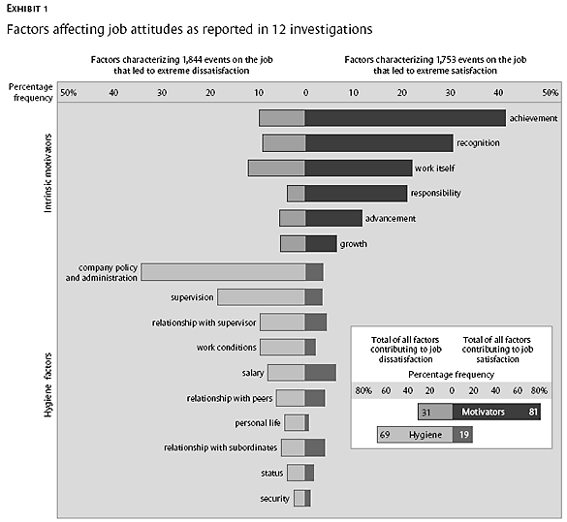

Slide 6
Treating Human Resources Like Human Beings
& Getting the Job Done
Pay
  Living wage
  Fair & comparable
  Merit pay
  Profit sharing
  Benefits
  Non-financial

Slide 7
Treating Human Resources Like Human Beings
& Getting the Job Done
Hiring
  Determining real needs
  Key accountabilities
  Recruiting
  Interviewing
  Hiring
  Employment contract

Slide 8
Treating Human Resources Like Human Beings
& Getting the Job Done
Performance Appraisal
  Key accountabilities
  Performance standards
  Self-evaluation
  Coaching
  Annual appraisal
  Not tied to compensation

Slide 9
Treating Human Resources Like Human Beings
& Getting the Job Done
Firing
  Hard to do (courage)
  Progressive discipline
  Documentation
  Employment law
  Common law

Slide 10
Treating Human Resources Like Human Beings
& Getting the Job Done
Legal
  Ethics
  Human Rights Code
  Employment Standards Act
  Common law

Slide 11
Treating Human Resources Like Human Beings
& Getting the Job Done
Burning Questions?
&
Discussion
Rhythm Communications

Slide 12
Treating Human Resources Like Human Beings
& Getting the Job Done
Roundtable Evaluation

Slide 13
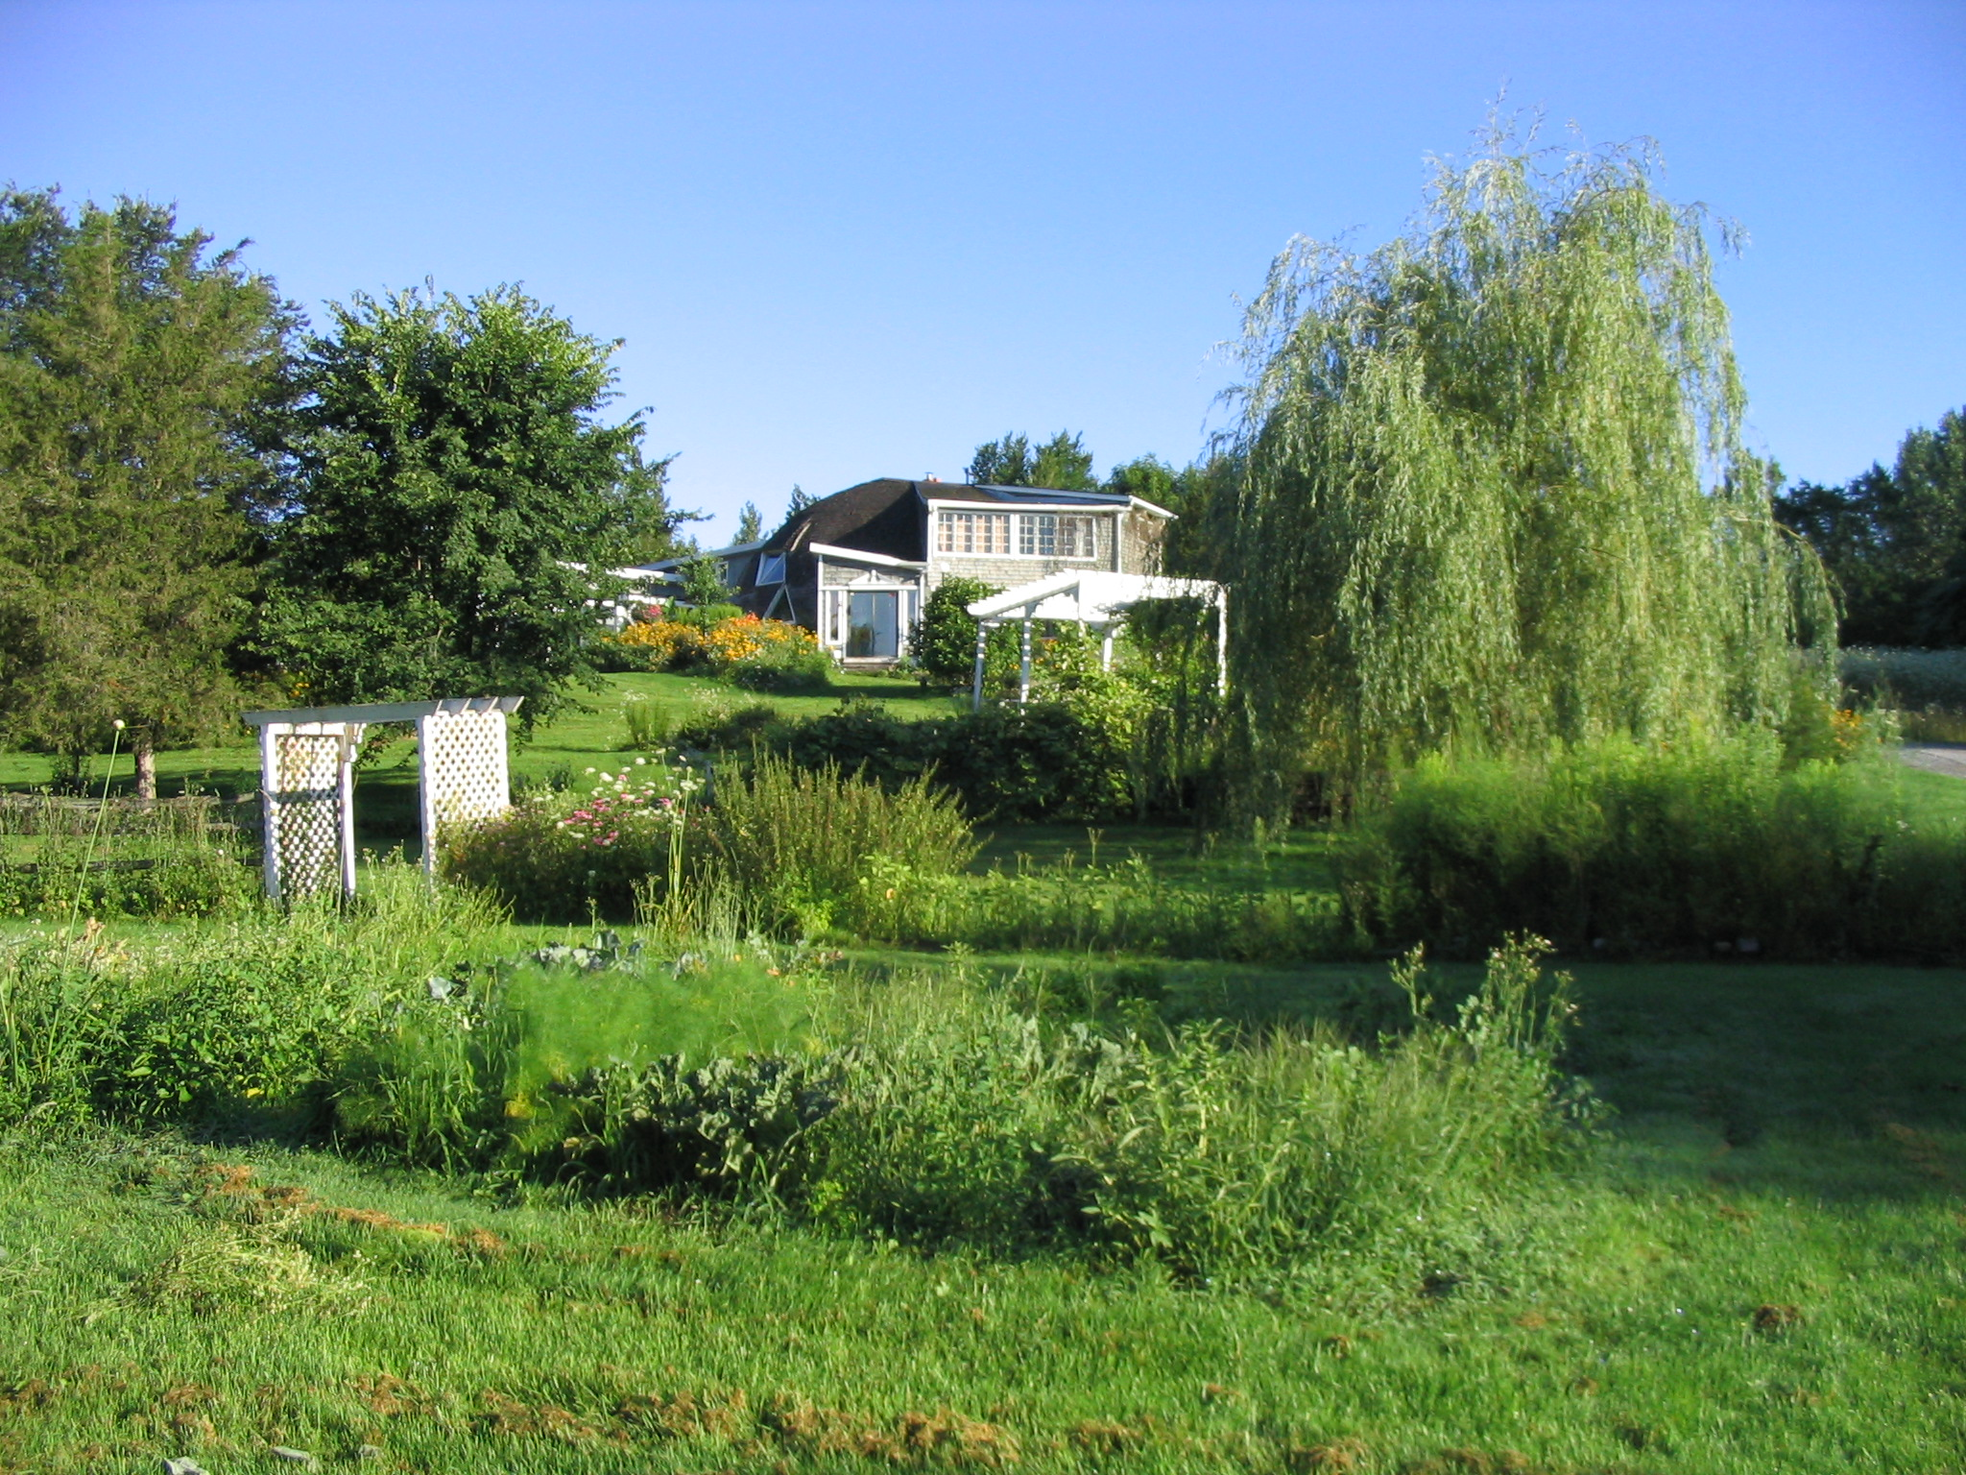
Thank You!
russ.c@xplornet.com

