Slide 1
Household Food Insecurity in Canada in 2012
Valerie Tarasuk and Catherine Mah
University of Toronto
Acknowledgement: This research was funded by operating grants from the Canadian Institutes of Health Research. This presentation draws on the work of Lynn McIntyre, Herb Emery, Naomi Dachner, Andy Mitchell, Rachel Loopstra, Urshila Sriram, Jenny Godley, and Geneviève Jessiman-Perreault.

Slide 2
FINANCIAL INSECURITY and INSUFFICIENCY
Food insecurity: uncertain and insufficient access to food arising from resource constraint
Reduced food intake
Reduced quality of food intake
Hunger
Adverse socioemotional effects
Stress, worry & anxiety
Social exclusion
Potential
Manifestations:
Severity and Duration
Poor nutritional status
Chronic health conditions
Obesity
Poor child development and learning
Compromised mental health
Potential
Health Outcomes:

Slide 3
Household Food Security Survey Module (administered on the Canadian Community Health Survey since 2004)
18 questions, differentiating adults’ and children’s experiences over last 12 months:
Worry about not having enough food
Reliance on low-cost foods
Not being able to afford balanced meals
Adults/children skip meals
Adults/children cut size of meals
Adults/children not having enough to eat
Adults/children not eating for whole day
“because there wasn’t enough money to buy food?”

Slide 4
Household Food Insecurity in Canada in 2012
Worry about running out of food and/or limit food selection because of lack of money for food.
Compromise in quality and/or quantity of food due to a lack of money for food.
Miss meals, reduce food intake and at the most extreme go day(s) without food.
Data Source: Statistics Canada, Canadian Community Health Survey (CCHS), 2007, 2008, 2011 and 2012.

Slide 5
Household Food Insecurity in Canada in 2012
12.6% of households reported some food insecurity.
4 million Canadians lived in food-insecure households in 2012.
1 in 6 children under the age of 18 (i.e., 1.15 million children) lived in food-insecure households.
Relationship to food bank statistics?
882,188 individuals received assistance from food banks in March 2012 (Food Banks Canada, HungerCount 2012).

Slide 6
12.6%
13.4%
16.2%
17.5%
15.6%
13.5%
11.7%
12.1%
12.5%
11.5%
12.7%
17.1%
20.4%
45.2%
Data Source: Statistics Canada, Canadian Community Health Survey (CCHS), 2012.

Slide 7
Prevalence of household food insecurity in major census metropolitan areas, 2011-2012
Data Source: Weighted estimates from CCHS 2011-12

Slide 8
Prevalence of household food insecurity
by income, 2011

Slide 9
In addition to income, other factors associated with heightened vulnerability to food insecurity include:
Not owning one’s home
Being aboriginal or black
Being a recent immigrant
Living in urban Canada
Being in a lone-parent, female-led household
Relying on social assistance

Slide 10
Data Source: CCHS 2011-12
Note: PEI and Northwest Territories have been omitted because of the small size of the samples there.

Slide 11
Why are social assistance recipients so vulnerable?
Incomes fall below basic living costs in most jurisdictions.
Most provinces do not index benefits to inflation.
Limits on allowable assets mean recipients have typically have no savings and therefore no capacity to buffer sudden increases in expenses or interruptions in income.

Slide 12
15.7%
10.6%
Drop in food insecurity between 2007 and 2011 reflects decreased vulnerability of social assistance recipients with province’s Poverty Reduction Strategy launched in 2006.
Among the changes:
Social assistance benefits were increased and indexed benefits to inflation.
Asset limits and earnings exemptions were raised.
(R Loopstra, unpublished analysis.)

Slide 13
Most food insecure households are reliant on employment incomes.
% food insecure
Data Source: CCHS 2011-12

Slide 14
Why are so many households reliant on employment incomes food insecure?
low-waged jobs
short-term, part-time employment
single (vs dual) earner households
inadequacy of income transfers provided to supplement low employment incomes

Slide 15
The low rate of food insecurity among Canadian seniors reflects the effect of policy interventions targeting income.
In 2012, 7% of households reliant on seniors’ incomes were food insecure.
versus 11% among those reliant on employment and 70% among those on social assistance.
Seniors have guaranteed annual incomes, indexed to inflation, and drug coverage, transit subsidies, ‘seniors days’ discounts.
Turning 65 drops the risk of food insecurity in half for low-income adults. (Emery, Fleisch and McIntyre. How a Guaranteed Annual Income Could Put Food Banks out of Business, University of Calgary SPP Research Papers, Dec 2013)

Slide 16
Reducing food insecurity means intervening upstream, to tackle the severe financial constraints that give rise to this problem.
FINANCIAL INSECURITY and INSUFFICIENCY
Food insecurity: uncertain and insufficient access to food arising from resource constraint
Reduced food intake
Reduced quality of food intake
Hunger
Adverse socioemotional effects
Stress, worry & anxiety
Social exclusion
Potential
Manifestations:
Severity and Duration
Poor nutritional status
Chronic health conditions
Obesity
Poor child development and learning
Compromised mental health
Potential
Health Outcomes:

Slide 17
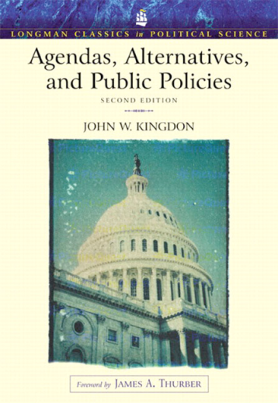
Food insecurity policy actors: social network analysis
Part of policy framing analysis, team led by McIntyre and Mah; purpose: to examine the makeup of the policy community for this issue
1
Nominate 3 ‘policy entrepreneurs’
Three sets of qualities
Voice or claim to be heard
Connections or able to forge strategic relationships
Tenacity – persistence
Explain reasons for nominations
Identify areas of policy influence
State relationship with nominee
Consultation with research team, network, and partners to assemble roster
93 policy actor roster members
2
Survey
3
Social network analysis
70 roster members completed the survey, naming 117 unique nominees, of which 35 were roster members
‘Ego-centred’ network of 160 individuals, of which 11 were most frequently nominated = policy ‘entrepreneurs’

Slide 18
93 roster
members
160 individuals
in the network
11 entrepreneurs

Slide 19
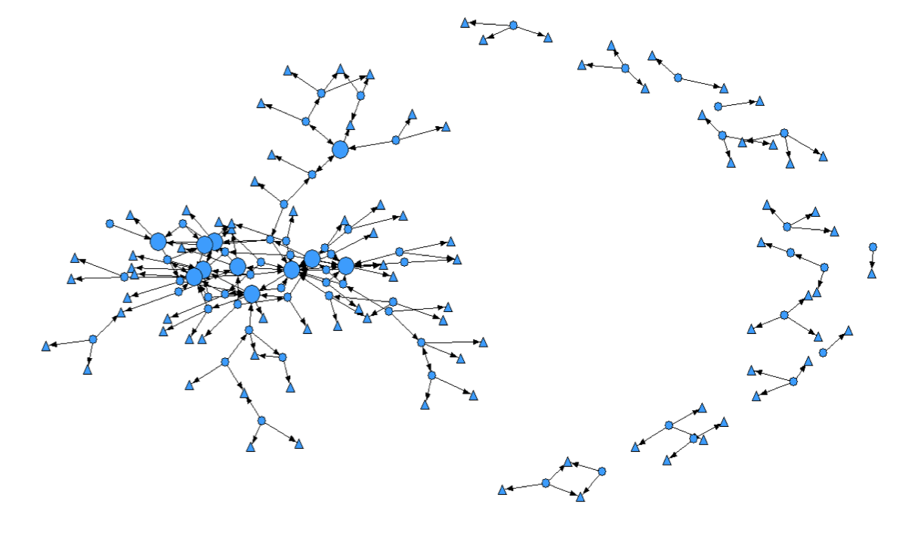
Figure 1: Food insecurity policy network representation (n=160)
Large circles = policy entrepreneurs
Triangles = nonrespondent nominees
Circles = respondents (roster members)
Main ‘network’ component
Findings:
Most common policy role across network: academic (26.5%) and NGO (26.5%)
Few decision makers in government

Slide 20
Figure 2: Food insecurity policy network representation (colour-coded by region, n=160)
BC – Green
AB – Red
SK – Grey
MB – Yellow
ON – Blue
QC – Brown
NS – Pink
NL – Orange
NU – Purple
NWT – Teal
Findings:
Horizontal network
Predominance of Ontario, followed by BC
Regionally focused – nominations in own region

Slide 21
Figure 4: Food insecurity policy network representation (colour-coded by approach, n=160)
Food-based – Red
Mixed – Grey
Income-based – Blue
Analysis of network homophily (post-hoc)
Findings:
Like-minded individuals connect
‘Mixed’ as bridge?
11 entrepreneur nominations: approach not as important as perception of formal role, action, voice

Slide 22
Food insecurity policy actors: social network analysis
Next step: interviews with entrepreneurs
Questions for discussion
What questions does this network analysis raise for you within the context of your own work?
How do these findings relate to your views on the key ingredients for policy change? How about policy change within jurisdiction of different orders of government (municipal-regional, provincial, federal)?
What is the role of ‘mixed’ approach actors?
Given the relative absence of governmental actors (consider legislative and executive), what are the implications for your own work?

Slide 23
Reducing food insecurity means intervening upstream, to tackle the severe financial constraints that give rise to this problem.
FINANCIAL INSECURITY and INSUFFICIENCY
Food insecurity: uncertain and insufficient access to food arising from resource constraint
Reduced food intake
Reduced quality of food intake
Hunger
Adverse socioemotional effects
Stress, worry & anxiety
Social exclusion
Potential
Manifestations:
Severity and Duration
Poor nutritional status
Chronic health conditions
Obesity
Poor child development and learning
Compromised mental health
Potential
Health Outcomes:

Slide 24
For emerging research, please subscribe to our website: http://nutritionalsciences.lamp.utoronto.ca
Note: On our website, you can find links to the research papers and reports referred to in this presentation. If you have trouble accessing this material, please ‘Contact Us’ by following that link on the website.

