Slide 1

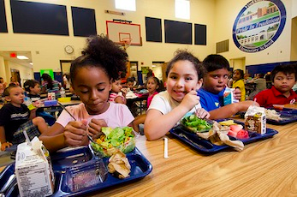
DIG INTO CANADA’S BIGGEST SCHOOL PROGRAM – ONTARIO
-------------------------
DANS LES COULISSES DU PLUS GRAND PROGRAMME ALIMENTAIRE SCOLAIRE AU CANADA: L’ONTARIO
Thursday, MAY 21, 2015, noon – 1 PM EDT
Hosted by Food Secure Canada
-------------
JEUDI, 21 MAI 2015, 12 h – 13 h Heure avancée de l’Est
Organisé par le Réseau pour une alimentation durable
with / Avec
Student Nutrition programs for central and East Ontario- Farm to school BC – Ontario Ministry of children and Youth services – Ottawa school breakfast program – Public Health Ontario

Slide 2

WEBINAR ETIQUETTE – CONSIGNES À SUIVRE
ENGLISH Please ensure that your computer microphone remains muted until the designated question period. To unmute, click the microphone icon to the left of your name, located in the participant list. If you are connected via landline, please ensure that your telephone is muted. If you would like to ask a question or comment before the question period, please enter it in the chat box at any time. While we welcome critical discussion, please be respectful and considerate of others. | FRANÇAIS Veuillez vous assurer que le microphone de votre ordinateur reste coupé jusqu’à la période de questions. Pour activer le son, cliquez sur l'icône du microphone vers la gauche de votre nom, située dans la liste des participants. Si vous êtes connecté via un téléphone fixe, assurez-vous que le son de votre téléphone est coupé. Si vous souhaitez poser une question ou émettre un commentaire avant la période des questions, veuillez utiliser la boîte de dialogue. Nous sommes ouverts à toute forme de discussion, à condition d’être respectueux et attentif aux autres.

Slide 3


Tracy McMurray
Manager, Child and Youth Development Branch
Ministry of Children and Youth Services

Slide 4

ONTARIO’S STUDENT NUTRITION PROGRAM
Food Secure Canada Webinar
May 21, 2015

Slide 5

History
1996 - Provincial funding given to Breakfast for Learning
2005 - Multi-agency delivery approach implemented
2013-14 school year
  Over 756,000 children/youth served
  Over 4,450 programs
  By end of 15-16 school year, 65% of schools in Ontario will have a provincially funded SNP

Slide 6
Program Model
Government is a “seed” funder
14 Lead Agencies are funded to operate the program within specific geographic areas
Large fundraising component from the local community and /or school
Involvement of national and local charities
Volunteer driven
Supports the healthy development of children and youth and their readiness to learn

Slide 7
  Investments
2008-2014 Poverty Reduction Strategy - $9.4M
  700 new programs in higher needs schools
  Enhancement to existing programs
2013 Healthy Kids Strategy - $3M
  200 new programs in higher-needs schools
  Introduction of Food & Logistics Coordinators
  Expansion into some on-reserve educational settings
2014-2019 Poverty Reduction Strategy - $10.3M
  340 new programs in higher needs schools
  Enhancement to existing programs
  Further expansion to on-reserve educational settings
2015-16 provincial funding $31.2M

Slide 8
Next Steps
Complete implementation of new programs
Working with First Nations partners to develop and implement programs
Program review and development of program outcome framework
Update program nutrition guidelines and develop nutrition guidelines for First Nations

Slide 9

THANK YOU!
Tracy McMurray
Manager, Child and Youth Development Branch
Ministry of Children and Youth Services
416-326-0339 tracy.mcmurray@ontario.ca www.ontario.ca

Slide 10


Ontario Student Nutrition Program Network
Nicola Lyle
Carolyn Hunter
Regional manager of Student Nutrition Program
Director of Ottawa School Breakfast program

Slide 11

Ontario Student Nutrition Program
Presenters:
Carolyn Hunter & Nicola Lyle, Co-Chairs
Ontario Student Nutrition Program Network
(with acknowledgement to Catherine Parsonage, TFSS for presentation material)

Slide 12
Ontario Student Nutrition Program - Key Stakeholders
Ontario Ministry of Children and Youth Services (MCYS)
$32M Funding
Program Principles / Guidelines
Program Nutrition Guidelines
National Funding Partners:
Breakfast Club of Canada
Breakfast for Learning
The Grocery Foundation
54 Community Partnerships or Flow-through Agencies
Provide local expertise
Support community fundraising initiatives
Work with local Community Development Coordinators
14 Lead Agencies
(Ontario Student Nutrition Program - OSNP)
Representing all areas of Ontario
Contract with MCYS
Oversees delivery of OSNP with Community Partnerships and Flow-through agencies
Local Schools
Notes:
The Ontario Student Nutrition Program Network (OSNPN) is comprised of representatives from the 14 Lead Agencies who administer provincial grant funds to support the development and implementation of healthy breakfast, snack and at times lunch programs across the province. These 14 Lead Agencies in turn, work with over 54 Community Partnerships across the province that bring together representatives from school boards, public health units, communities and parents, to provide a network of support for school programs at the local level.

Slide 13
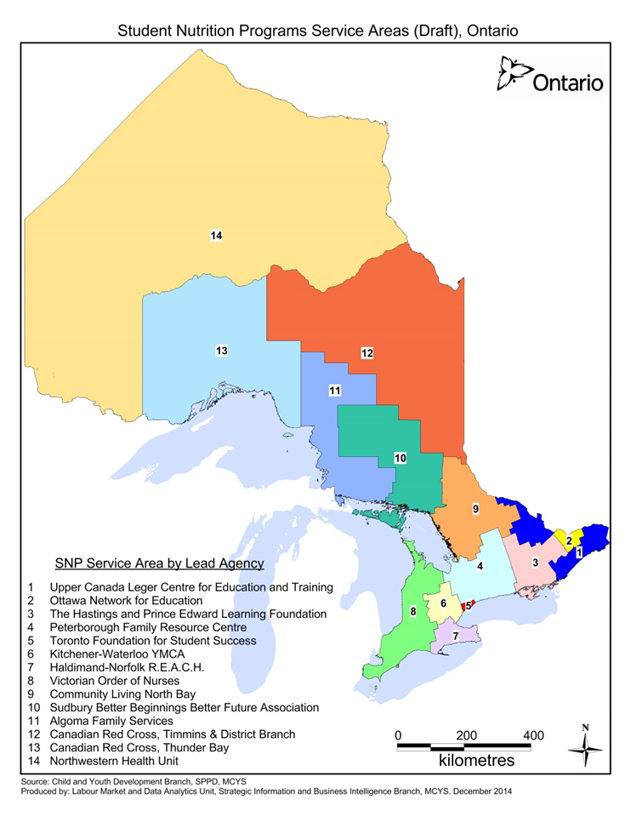
Who We Are

Slide 14
Ontario Student Nutrition Program numbers (2013-14)
Total Students 756,000
Total Programs 4,474
Total Meals 77,841,819
Based on 2013/2014 quarterly reporting

Slide 15


What Guides Our Work
1. Program Guidelines
Principles and criteria
Service delivery models
Program food
Funding and Administration
Data requirements
These guidelines apply to all stakeholders involved in the program.

Slide 16
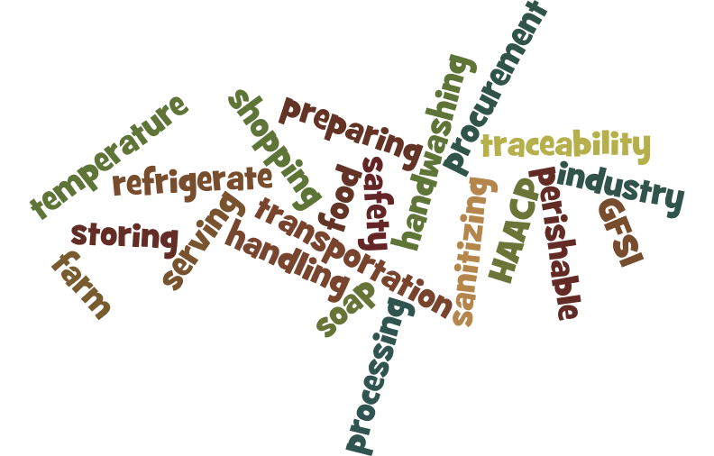
What Guides Our Work
Program Principles
1. Universal access to programs
All children and youth at each SNP site have the opportunity to access the program.
Programs are non-stigmatizing and do not single out participating children and youth.
2. Safe and nutritious food is served
The foods offered (whether purchased or donated) are nutritious and follow the SNP Nutrition Guidelines (2008)
Food offered is sensitive to faiths and
cultures of children, youth and their families
Student Nutrition Program facilities follow
and respect public health regulations
Supply sources of program food adhere to industry best practices related to food safety and traceability

Slide 17

What Guides Our Work
Program Principles (cont.)
3. Community Involvement
Local stakeholders are engaged in the design, implementation and administration of the program so that programs can address specific site and community needs
Child and youth participation is encouraged as much as possible
Parents and/or caregivers are welcomed and encouraged to support and contribute (financially and/or volunteering) to programs according to their ability
Fundraising and partnership development within the broader community occurs to increase the funding base of the program

Slide 18
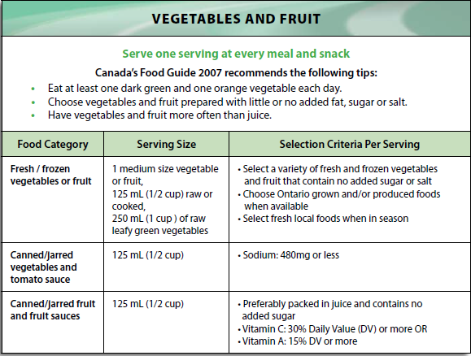
What Guides Our Work: Nutrition Guidelines
2. Nutritional Guidelines
These guidelines are intended to assist Student Nutrition Program (SNP) providers in selecting nutritious foods for breakfasts, lunches and snacks.
Principles
Promote healthy eating
Prepare healthy food
Respect diversity and individual student
needs
Contribute to Social Development
Choose Ontario first
Be environmentally conscious
Practice safe food handling and storage

Slide 19
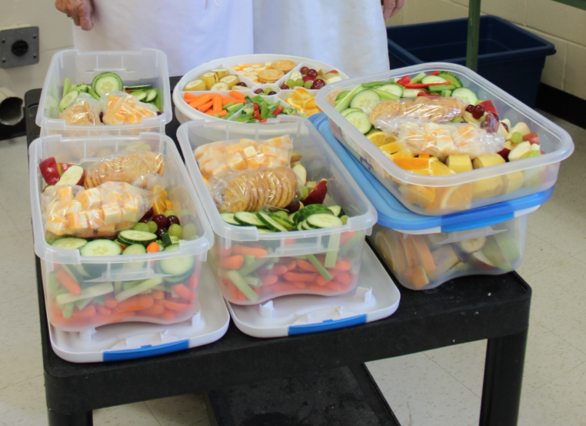
What Guides Our Work: Nutrition Guidelines
Breakfast or Morning Meal
3 food groups including at least one serving of fruit/vegetable and dairy
Served either before school begins or sometime during the morning
A variety of models exist: sit-down programs, grab & go, and bin models are the most common

Slide 20

What Guides Our Work: Nutrition Guidelines
Lunch
Same as breakfast and morning meal but served in the middle of the day
Snack
2 food groups including at least one serving of fruit/vegetable
Can be served anytime during the school day
Grab and go and bin models are common

Slide 21
Ontario Student Nutrition Program - The Network!
OSNPN
The Ontario Student Nutrition Program Network:
www.osnpn.ca
WHO: Representatives from each of the 14 Lead Agencies
Role: The OSNPN is committed to building the capacity of regional lead agencies to support meal and snack programs servicing children and youth across the Province of Ontario.
Goal: To work strategically at a provincial level to build awareness and support so that students across Ontario can experience the positive social, academic and health outcomes that are often associated with increasing access to healthy foods in schools

Slide 22
OSNPN - How We Work Together-Our Collaboration Tools
Ontario Student Nutrition Program Network (OSNPN )
[14 Lead Agency Representatives]
Monthly Teleconference Meetings
Wiki site – centralized document and information
Annual Conference
Liaison structure with subcommittees and networking groups

Slide 23
OSNPN – How We Work Together – Our Structure
Ontario Student Nutrition Program Network (OSNPN )
[14 Lead Agency Representatives]
OSNPN
Terms of Reference
2 Co-chairs – staggered 2-year terms
Decision by consensus
OSNPN Liaison
OSNPN Liaison
OSNPN Liaison
OSNPN Liaison
Key Partners Subcommittee
Food and Logistics Subcommittee
Communications
Subcommittee
Community Development Coordinators Networking Group

Slide 24
OSNPN – How We Work Together – Key Partners
Ontario Student Nutrition Program Network (OSNPN )
[14 Lead Agency Representatives]
Key Partners Subcommittee:
A standing committee of the Ontario Student Nutrition Program Network
Goal: to explore partnerships than may span multiple regions or the Province of Ontario and to ensure Lead Agencies are aware and informed about potential partnership opportunities.
The Key Partners Subcommittee will receive requests for OPSN endorsement and present these to the larger committee for their consideration.
Examples of Some Key Partners:
  Breakfast Club of Canada
  Breakfast for Learning
  The Grocery Foundation
OSNPN Liaison
Key Partners Subcommittee

Slide 25
OSNPN – How We Work Together – Food & Logistics
Ontario Student Nutrition Program Network (OSNPN )
[14 Lead Agency Representatives]
Food and Logistics Subcommittee
Is a standing committee of the Ontario Student Nutrition Program Network.
The Committee focuses on food procurement for student nutrition programs across Ontario and is committed to developing partnerships that benefit the children and youth in the Ontario Student Nutrition Program through the procurement of safe, nutritious and cost effective food
OSNPN Liaison
Food and Logistics Subcommittee

Slide 26
OSNPN – How We Work Together – CDC Networking
Ontario Student Nutrition Program Network (OSNPN )
[14 Lead Agency Representatives]
Community Development Coordinators Networking Group
Is a Subcommittee of the Ontario Student Nutrition Partnership Network.
Goal: to share best practices in order to support the provincially mandated role of the Community Development Coordinators that are funded through Lead Agencies across Ontario.
OSNPN Liaison
Community Development Coordinators Networking Group

Slide 27

Impact of Student Nutrition Programs
Feeding Our Future was a universal student nutrition program in the Toronto District School Board. During its first and second year, it was the subject of an evaluation project.
Highlights of Results:
Principals and teachers surveyed perceived that student attitude, behaviour, and rate of tardiness improved, including reduced disciplinary problems, suspension rates and absenteeism
EQAO (Ontario’s standardized testing) scores improved, and there was increased Grade 9 credit accumulation
Students reported increased energy, ability to concentrate, and better health
Students also reported that the program got them in the habit of eating breakfast, and increased their overall consumption of dairy products
Increased graduation rates for secondary students were also noted

Slide 28
Read the Research
The Feeding Our Future report can be found here:
On the Toronto Foundation for Student Success’ website (the Lead Agency for SNPs in the City of Toronto) at www.tfss.ca
or
On the Ontario Student Nutrition Program Network website www.osnpn.ca

Slide 29
Questions and Comments
?

Slide 30

Thank you
Learn more about Ontario Student Nutrition Programs, visit us at:
www.osnpn.ca
Photo: Ottawa School Breakfast Program

Slide 31

MICHELLE VINE
Evaluation specialist in health promotion, chronic disease and injury prevention at public health Ontario
Notes:
Rates of child/adolescent obesity (2004-2009) are virtually identical between Canada and the US, at 30%.
High rates of obesity translate to a tremendous BURDEN of ILLNESS on the health care system, individuals, and families.
Direct costs: medications, hospital and physician care, links with chronic diseases- cardiovascular disease and cancer
Indirect costs: lost years of life to premature death, reduced QOL, lost person-days of work
“Given that young people are vulnerable to overweight and obesity, and that the ensuing health implications are varied and unique, differing from those of adults, the obesity-related health outcomes of children and adolescents need to be studied separately. In addition, there is a strong propensity for overweight and obesity to persist into adulthood” (Roberts, et al., 2012).
Obesogenic Environments
An ecological approach defines “obesity as a normal response to an abnormal environment, rather than vice versa”; increased focus on the environment as an important pathway to human health
“An exploration of environmental components (e.g., social, economic, political and physical) shaping school nutrition policy will help develop an understanding for the role of the school environment in either promoting or inhibiting opportunities for healthful eating.”

Slide 32
Evaluating the School Nutrition Policy Environment in Ontario Canada
Dr. Michelle Vine, PhD
Adjunct Assistant Professor
School of Public Health & Health Systems
University of Waterloo
Evaluation Specialist, Public Health Ontario
E: Michelle.Vine@oahpp.ca

Slide 33
Environment & Obesity
Obesity
  Individual, families, health care system
  Burden of Illness: direct and indirect
Response to obesity
  Individual-level
  Obesity and the Environment: increased focus on the environment as an important pathway to human health
Healthy Kids Strategy Report (2013): underscores the need to create healthy communities by making schools hubs for child health and community engagement
Notes:
Rates of child/adolescent obesity (2004-2009) are virtually identical between Canada and the US, at 30%.
High rates of obesity translate to a tremendous BURDEN of ILLNESS on the health care system, individuals, and families.
Direct costs: medications, hospital and physician care, links with chronic diseases- cardiovascular disease and cancer
Indirect costs: lost years of life to premature death, reduced QOL, lost person-days of work
“Given that young people are vulnerable to overweight and obesity, and that the ensuing health implications are varied and unique, differing from those of adults, the obesity-related health outcomes of children and adolescents need to be studied separately. In addition, there is a strong propensity for overweight and obesity to persist into adulthood” (Roberts, et al., 2012).
Obesogenic Environments
An ecological approach defines “obesity as a normal response to an abnormal environment, rather than vice versa”; increased focus on the environment as an important pathway to human health
“An exploration of environmental components (e.g., social, economic, political and physical) shaping school nutrition policy will help develop an understanding for the role of the school environment in either promoting or inhibiting opportunities for healthful eating.”

Slide 34
School Nutrition Environment
Ontario, Canada
Focus on the school nutrition environment in Ontario, Canada
NEW Ontario School Food and Beverage Policy (P/PM 150, Ministry of Education, 2010)
Notes:
“Schools are an important element of the local environment for several reasons, including: 1) children and adolescents spend a large portion of their waking time at school, and are considered to be a “captive audience”; 2) school is an important social and physical environment for children and changes to these environments have been shown to impact health; 3) teachers can provide leadership, role modeling, support, reinforcement and feedback, and monitor progress; and 4) promoting the health of students is linked to greater academic achievement (Parcel et al., 2000). In this way, schools have been the setting for focused heath promotion interventions in the area of obesity and nutrition.”
WHY ONTARIO? We chose to focus on the province of Ontario given its diversity, that nearly 40% of the Canadian population resides in Ontario, that a new school nutrition policy was implemented just two years ago, and that very little research has been undertaken on the school nutrition policy environment in Ontario.
The School Nutrition Environment in Ontario, Canada
In September, 2011 the Ontario Ministry of Education implemented a new School Food and Beverage Policy (PPM 150), across all 72 school boards in the province.
In addition to P/PM 150, partial provincial funding is provided through the Ontario Student Nutrition Program
There are many school-based, course based nutrition programs as well.
What is P/PM 150?
“In September 2011 the Ontario Ministry of Education implement/ed a new School Food and Beverage Policy (P/PM 150)⁽²¹⁾, across all 72 school boards in the province. In conjunction with the Ontario Government’s commitment to make schools healthier, P/PM 150 strives to contribute to improved educational, attitudinal (e.g., food preferences and eating behaviours) and health-related outcomes, including reducing the risk of students’ developing chronic diseases, including type 2 diabetes, cancer, and heart disease via nutritional standards (i.e., sell most, sell less, not permitted for sale). P/PM 150 allows for ten special-event days where food and beverages sold in schools are exempt from the nutrition standards. Additional requirements include that schools: comply with the Trans Fat Standards set out in Ontario Regulation 200/08 and Regulation 562 related to preparing, serving and storing food and beverages; develop strategies to reduce the risk of exposure to anaphylactic causative agents; ensure student access to drinking water during the school day; and, consider the diversity of students and staff through the accommodation of religious and/or cultural needs⁽²¹⁾. P/PM 150 also recommends that boards, if available and possible, sell Ontario produced food and beverages, and avoid offering food and beverages as an incentive to students.”

Slide 35
Population Health Framework
Population health framework: health outcomes are shaped by interactions and patterns between multiple determinants of health, including:
    Social environment (income, education, social support)
    Physical environment (urban design)
    Individual behaviour (physical activity, food intake)
    Genetics
Notes:
This research was guided by the principles of the population health framework, and the ANGELO framework.
From a population health perspective, health outcomes are shaped by interactions and patterns between multiples determinants of health, including aspects of the social environment (income, education, social support); aspects of the physical environment (urban design); individual behaviour; and, genetics. Health researchers are encouraged to consider the social determinants of health outside of the health care sphere, including in areas such as education, and social support. Specifically, the current thesis adopts a population health approach to consider the complexity of interactions between environmental factors shaping school nutrition policy implementation in Ontario, Canada.

Slide 36
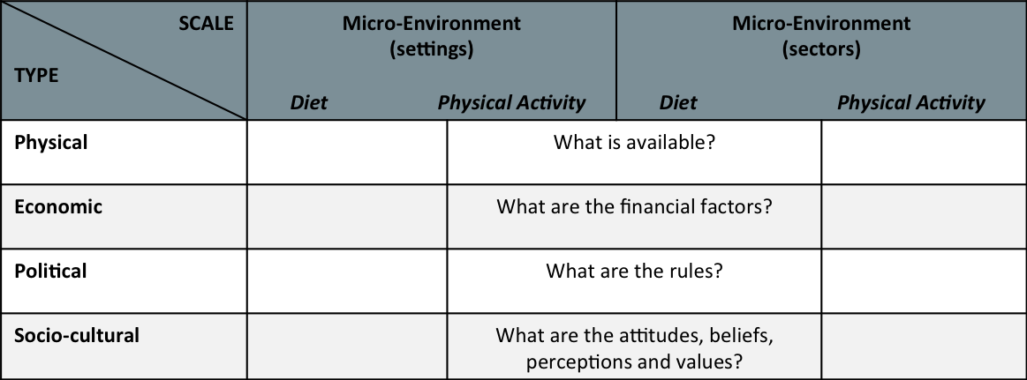
ANGELO Framework
Analysis Grid for Environments Linked to Obesity (ANGELO) framework (adapted from Swinburn, Egger & Raza, 1999)
Notes:
The Analysis Grid for Environments Link to Obesity (ANGELO) framework is a conceptual model developed to identify specific factors contributing to an obesogenic environment. The ANGELO framework is a two by four grid that divides FOOD and PHYSICAL ACTIVITY environments by level (micro and macro) and type (economic, sociocultural, physical, political).
“The physical environment refers to "what is available", including both visible and less tangible factors such as nutrition education and training opportunities. The sociocultural environment refers to the attitudes and values associated with a community or society. The economic environment includes the cost of food, and interventions that may affect food intake (e.g., taxes, subsidies). Laws, regulation, policies and institutional rules affect the food-related behaviour of individuals (political environment)” (Swinburn, Egger & Raza, 1999).

Slide 37
Research Objectives
This research had three objectives:
To explore the consistency of policies across a range of spatial contexts (i.e., National, Provincial, regional),
To examine the perceptions of key stakeholders who are involved in policy implementation, and,
To investigate the perceptions of the user group.

Slide 38
Research Methods
Document Analysis
Key Stakeholder Interviews
Student Focus Groups
Mixed qualitative methods
Notes:
Data analysis and interpretation occurred concurrently with data collection; qualitative analysis is an iterative process.²⁰ A theme code manual was developed based on the principles of the ANGELO framework. Data were entered into a qualitative analysis software package (NVivo 8.0) for subsequent thematic analysis
This brief presentation will focus only on the findings of key stakeholder interviews and student focus groups.

Slide 39
Findings: Key Stakeholders
Economic environment – cost of healthy food for sale, loss of revenue generation
Physical environment – proximity of schools to off-site food outlets, link between healthy eating and student learning
Political environment – restrictive nature of policy guidelines, role of key stakeholders
Sociocultural environment – role of stigma, school culture
Notes:
ECONOMIC ENVIRONMENT: Results reveal a link between the new provincial food and beverage policy, the cost of healthy food for sale and a loss of revenue generation. Given the higher cost of policy-compliant (nutritious) food for sale in the cafeteria, respondents recognized that policy guidelines act as a barrier, particularly for vulnerable students, for whom opportunities to access food (healthy or otherwise) may already be constrained at home. While the cost of healthy food for sale was a concern across all schools in the study, it was more pronounced in schools where a larger percentage of the school population was considered low income. Results indicate that stringent nutrition policy guidelines lead some students off campus to fast-food outlets and/or grocery stores, where food is less costly.
The focus of policy – selling nutritious foods at school more than 80% of the time – raises the cost of food for sale and, subsequently, reduces the number of student food purchases at school. As a result, given that schools receive a portion of funding from cafeteria and related food sales (e.g. tuck shops, vending machines), reduced food sales result in lower revenue. Thus, schools are required to engage in more fundraising activities.
Opportunities for food-related school fundraising within PPM 150 are limited as bake sales are restricted to ten days per school year. Given that cafeteria providers appear unable to provide nutritious food within the nutritional confines of the policy at an appropriate cost, schools risk losing revenue and, ultimately, risk losing their cafeteria. A revenue loss means that cafeteria staff risk losing their jobs, which means that students face the double burden of: (i) being unable to afford the healthy food being offered for sale in the cafeteria (despite the option to bring food from home); and (ii) playing a larger role in food production in the cafeteria, as part of their family studies/food courses. Respondents revealed the tension between, on one hand, providing nutritious foods to students and, on the other, the revenues that schools gain as a result of selling unhealthful foods.
PHYSICAL ENVIRONMENT: Respondents revealed that the close geographical proximity of schools to fast-food outlets acted as an obvious barrier to policy implementation. Students attending schools located near a downtown core were more likely to be in walking distance of inexpensive, unhealthy foods and thereby were more likely to purchase these types of foods. Loss of cafeteria revenue is at least partially related to unrestricted access to off-campus food outlets, resulting
in what school-based respondents perceived as competition between internal (i.e. school cafeterias, vending machines, tuck shops) and external community-based
food-service providers.
While some respondents highlighted the link between healthy eating and improved student learning, they also acknowledged the role of hunger as an acute barrier to student learning. The school food and beverage policy was designed to provide nutrition standards and criteria in schools. Although nutritional health was a key priority of many school-level respondents, issues of poverty and hunger also existed. According to one vice principal, ensuring that students are being fed healthy foods vis-a`-vis school meal programmes (e.g. subsidized food available to students who qualify) was deliberately connected to student learning. These, and other, types of strategies to promote healthy eating were common in many schools. Such strategies were consistent with PPM 150 in the contexts of nutritional standards and changing student eating behaviours and food preferences.
POLITICAL ENVIRONMENT: Some respondents revealed that the school food and beverage policy (i.e. nutrition standards, nutrition criteria) is restrictive in nature. In this way, a family studies teacher reported some of the barriers related to accessing policycompliant food, consistent with nutrition standards and criteria, available to sell in cafeterias. While many schools have a food-service provider in the cafeteria, in others, students in family studies/food courses are responsible for cafeteria food production. In addition to issues related to food-service provision, some respondents indicated that the policy guidelines were too restrictive in nature, and that secondary students should be given the option to make food-related choices on their own and in moderation.
There are a number of key stakeholders who are integral to the success of the school food and beverage policy, including: teachers, vice principals, principals, school healthy action teams, government representatives (both policy makers and funders), parents, students, cafeteria service providers, and members of the school council. While some respondents felt strongly that responsibility for school nutrition was at the school level, others felt that regardless of what schools are doing to promote healthy eating in schools, primary responsibility needed to lie with parents. Findings indicate that the role of public health in school nutritionpolicy implementation deserves further examination.
SOCIOCULTURAL ENVIRONMENT: Both community- and school-level respondents observed the stigma that students experience as a result of not having enough food and/or not having money to purchase food at school. Some schools provide students with cafeteria lunch coupons as a way of reducing stigma. Other strategies include inviting teachers and principals to join students for breakfast at the SNP in order to ensure students that they are universal in nature. SNP are mandated to be policy compliant (vis-a`-vis the 2008 Nutrition Guidelines), but given the high cost of nutritious food and a limited operating budget (SNP receive partial ministry funding, donations, and funds incurred by school fundraising), SNP are at risk of being shut down.
The culture of the school nutrition environment appears to be largely dependent on the buy-in of key school-level personnel. Teacher support for SNP is a vital component of their promotion and successful implementation at the school level. Role modelling behaviours help to create a culture in schools where nutrition programmes are seen as universal and acceptable.

Slide 40
Findings: Secondary Students
Economic environment –high cost of healthy food for sale, cost and quality of foods, impact on cafeteria revenue
Physical environment – proximity of schools to off-site food outlets, access to non-policy compliant foods, cafeteria space
Sociocultural environment – nutrition knowledge and education, time constraints as a predictor of healthy eating, student engagement
Notes:
ECONOMIC ENVIRONMENT: The high cost of food for sale in school cafeterias acts as a barrier to the consumption of nutritious food. In conjunction with the implementation of PPM 150, some schools saw the introduction of a new food service provider, which was accompanied by a rise in food prices. In addition, food prices and food quality were inconsistent.
High priced food led some students to purchase food off-campus. Students compared themselves to others in terms of how often they could purchase food during school hours. There was a link between what students could afford to eat at school, and their self-image. Not having enough money to purchase food during school hours created a sense of stigma. Lowering food prices seemed like an obvious solution. However, students were acutely aware that cafeteria sales generate profit, of which some schools receive a portion
PHYSICAL ENVIRONMENT: The physical environment includes proximity of schools to fast-food outlets, access to non-policy compliant-foods, and cafeteria space. Proximity to fast food outlets led to increased access during lunchtime hours, or during breaks. All participating schools were located in densely populated neighbourhoods in close proximity to numerous fast-food outlets, and many students chose to purchase food off-campus.
Access to non-policy compliant foods and beverages was also available through adjoining or affiliated buildings (e.g., vending machines in community recreation centres) not under the same jurisdictional guidelines. Given that the entire student body ate lunch during the same time period, one school did not have enough space in the cafeteria for students to eat together. At another school, in what was once considered a food friendly space, library renovations meant that students were prohibited from eating there.
SOCIOCULTURAL ENVIRONMENT: The sociocultural environment includes nutrition knowledge and education, time constraints as a predictor of healthy eating, and student engagement. While participants’ agree that knowledge and education about nutrition came mostly from their parents and the school curriculum, responses varied about the extent to which healthy eating was important to young people. Despite this, students were still cognizant of the positive impact of healthy foods on their health and wellbeing. Body image, self-esteem and mental health were also linked to healthy eating.
Results reveal that time constraints were a key factors shaping students' healthy eating behaviour. In addition, garnering student input on the issue of nutrition was an important opportunity to promote dialogue between students, teachers and administrators. Participants saw value in having their voices heard, identifying a lack of a formal communication strategy as it related to PPM 150.
Having a choice in the types of foods offered for sale in the school setting was one strategy for engaging students. At one school, several respondents were members of a school-based advocacy team developing an organic food garden in order to cook school meals, and support student education regarding crop sustainability and eating locally. Results reveal that the impetus for organic gardening was both social and economic in nature. One participating school offered a culinary arts program where students were involved in preparing foods for the school-based breakfast program. This program created a vital link between students and the nutrition environment, helping them to cultivate their culinary skills by preparing foods for other students in the school.

Slide 41
Discussion
Provision of nutritious food in school (why) translate to regional level vis-à-vis nutrition standards and nutrition criteria (how)
Accessibility of nutritious food in schools
Nutrition education
Notes:
Making nutritious food available to youth was a key priority at all levels. Broader community settings were the focus at the federal level, while the school setting was the primary focus at the provincial level. These broader federal and provincial level themes related to the provision of nutritious food in school (why) translated directly to the regional level vis-à-vis nutrition standards (i.e., sell most, sell less, not permitted for sale) and nutrition criteria (i.e., fat and sodium content) (how).
Although the accessibility of nutritious food in schools was a key federal level priority, it was less so at the provincial level, and virtually absent from regional level policy, which acts as a barrier if youth are being raised in families where food access is limited at both home and at school.
Nutrition education was a key federal and provincial level priority. The provision of nutrition education in the school vis-à-vis curricular changes and services related to healthy eating was perceived as vital at these higher-levels. Although a large proportion (92%) of regional-level policies included a statement about the link between nutrition and improved learning outcomes, there was a lack of information about strategies to improve the quality and amount of nutrition education provided at the school level. Given that education is under provincial jurisdiction, regional-level policy should reflect the provincial mandate.

Slide 42
Implications for Research
Future analyses of the external school food environment would help to facilitate and extend this research, particularly in the context of health-related policy
Evaluating policy implementation 4-5 years post-implementation would provide additional data regarding uptake and success, and behavioural outcomes (e.g., healthy food intake, external food purchasing behaviours, etc.)

Slide 43
Implications for Policy
Need to explore pricing strategies and food strategies & partnerships with local food providers
Findings warrant exploration of closed campuses and extending P/PM 150 to government buildings youth frequent
Student involvement/school garden initiatives
Role of stigma and school culture
Notes:
First, given the varied landscape of school nutrition policy in Canada and that a national school meal programme has yet to be developed, all cafeterias are revenue driven. Ontario currently lacks a provincial funding strategy tied to the school food and beverage policy, and the high cost of policy-compliant foods for sale acts as a key barrier at the school level. The implications of the high cost of nutritious foods are twofold: (i) students choose to go off campus to purchase food elsewhere; and (ii) schools subsequently generate less revenue from food sales. Some populations are more vulnerable than others, particularly in low-income neighbourhoods. The school is a vital setting for nutrition interventions, including offering subsidized breakfast, snack and lunch programmes via SNP. These findings support the need for a stronger financial commitment from both national and provincial governments to provide subsidized policy-compliant foods in schools through PPM 150 and local-level SNP.
Findings related to the proximity of schools to off-site fast-food outlets reveal important policy-related implications. Given that secondary-school students have access to the external food environment, a perception exists that schools are in competition with fast food and other off-site food outlets. Our findings indicate that students attending schools located in low-income neighbourhoods may be even more likely to purchase foods from the external food environment, and therefore may be at an increased risk of obesity and other nutrition related chronic diseases(2,34). Analyses of the external neighbourhood food environment surrounding schools are warranted in Ontario, Canada, particularly in light of the implementation of PPM 150.
Third, respondents consistently indicated that a range of key stakeholders could play a larger role in school nutrition policy implementation. Our findings reveal that consistent communications (e.g. newsletters, public meetings, student assemblies) between all stakeholders (e.g. government, school-level personnel, students, parents, community groups, public health) throughout policy implementation would enhance the process. Results of the present research also point to a need for a process to create more alignment and consistency between PPM 150 and SNP, which could be supported by public health dietitians given their expertise and knowledge about nutrition standards and criteria.
Fourth, reducing the role of stigma related to students accessing SNP in schools was a key concern. Our findings suggest that student participation in SNP is compromised because of the potential for it to identify them as low income(37). Role modelling healthy eating behaviours can positively impact the extent to which students experience stigma. While school-based strategies to reduce this stigma (i.e. emphasizing the universal nature of SNP, inviting teachers to attend) have been met with varying degrees of success, it is nevertheless an important priority. School culture was also raised as an important opportunity to promote and support PPM 150. For example, school garden initiatives have been shown to promote healthy nutritional intake, academic engagement and students’ sense of connection with their school(38). In addition, given that overweight and obese youth are at an increased risk of being the victims of physical and verbal abuse(3,4), there is an opportunity to explore the social environment and social networks in the context of food and issues of body image and disordered eating(39,40).

Slide 44
Public Health Implications
Need to explore pricing strategies and food strategies & partnerships with local food providers
Findings warrant exploration of closed campuses and extending P/PM 150 to government buildings youth frequent
Student involvement/school garden initiatives
Notes:
The high cost of food significantly impedes students' access to affordable, healthful foods in school cafeterias, particularly in low income neighbourhoods.⁹ As a result, schools see fewer students purchasing food in the cafeteria, and more students purchasing non-policy compliant-food off-campus. The implications of this change in purchasing behaviours are twofold: 1) food purchased off-campus may be less nutritious than cafeteria food; and, 2) schools risk experiencing a loss in cafeteria revenue. This study makes a contribution to the very limited Canadian literature on the financial impact of non-funded nutrition policies in schools.¹³ An opportunity exists to further explore the role of potential pricing strategies and food subsidies, including partnerships with local food providers.¹⁹
Access to non-policy compliant-food in adjoining buildings acts as a key barrier to successful implementation of PPM 150. Our findings are consistent with recent Canadian findings^{11,13,24-25}, which indicate that schools in close proximity to fast-food outlets (convenience stores and restaurants) are perceived to be in competition with each other, and result in inconsistent messaging about food. In response, closed secondary school campuses in the US – where students are not permitted to leave school property at lunch – have been explored; findings reveal that students on closed campuses consumed fast food and convenience store foods less frequently.²⁶ Closed campuses may be worth exploring in the Canadian context, particularly at the secondary school level where local barriers to PPM 150 include access to off-site and adjacent food outlets. Further, extending PPM 150 to government buildings which youth frequent (e.g., community centres, hockey arenas, pools) may also help to support student nutrition. This approach, however, would benefit from a provincial financial commitment in order to reduce the cost of healthy foods for sale in schools.
Student involvement in nutrition programs (i.e., breakfast, snack, lunch programs) through advisory councils and food preparation were useful ways to link students with their school nutrition environment, including peer modeling and communication with teachers and administrators who are responsible for food and nutrition. Our results indicate the value in school garden programs, particularly as a way of engaging student populations in food and nutrition issues. School garden initiatives are worth exploring further in this context, particularly given recent US evidence to support their important role in promoting nutritional intake, students’ connections with their school, and academic engagement.²⁸⁻²⁹

Slide 45


Acknowledgements
CIHR Institute of Nutrition, Metabolism & Diabetes New Emerging Team Grant
Canadian Home Economics Foundation

Slide 46
References
Vine, M.M., and Elliott, S.J. (2014). Examining local level factors shaping school nutrition policy implementation in Ontario, Canada. Public Health Nutrition, 17(6), 1290-1298.
Vine, M.M., and Elliott, S.J. (2014). Exploring the school nutrition policy environment in Canada using the ANGELO framework. Health Promotion Practice, 15(3), 331-339.
Vine, M.M., Elliott, S.J., and Raine, K.D. (2014). Exploring implementation of the Ontario School Food and Beverage Policy at the secondary school level: A qualitative study. Canadian Journal of Dietetic Practice and Research 75(3):1–7.

Slide 47



Please use the chat box for your questions
Veuillez utiliser la boite de dialogue pour vos questions

Slide 48
Thank you for joining us!
Merci pour votre participation!
www.foodsecurecanada.org
www.foodsecurecanada.org/fr
A complete recording of the webinar will be available on our website soon. Don’t forget to sign-up to the Children and Food Network to participate in our upcoming campaigns, and to receive curated notifications, news and events by email. To better serve our members, we would also like to invite you to complete a short evaluation of the webinar (link in the chat box). | Un enregistrement complet du webinaire sera bientôt disponible sur notre site Internet. N’oubliez pas de vous inscrire au Réseau de l’Alimentation des Enfants pour participer à nos prochaines campagnes, recevoir des notifications, des nouvelles et des événements par courriel. Afin de mieux vous servir membres, nous tenons également à vous inviter à remplir une courte évaluation du webinaire (lien dans la boîte de dialogue)

